Slide 1

Programa de
Mejoras Capitales
Infraestructura
Conversatorio sobre Proyectos de Reconstrucción de Infraestructura
Ing. Luis González Delgado, P.E
Presidente Ejecutivo AAA
Septiembre 2025

Slide 2

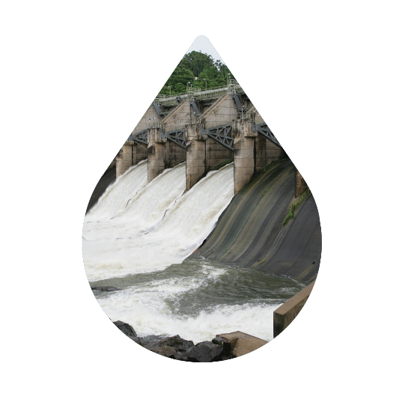
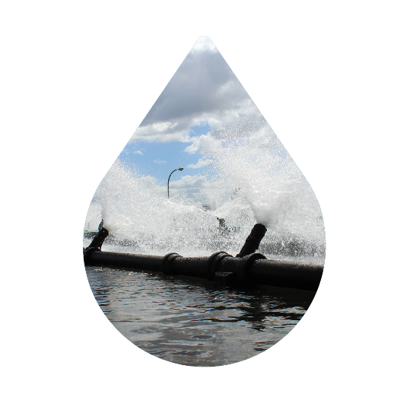
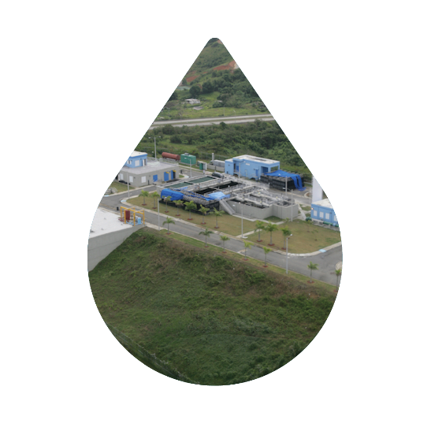
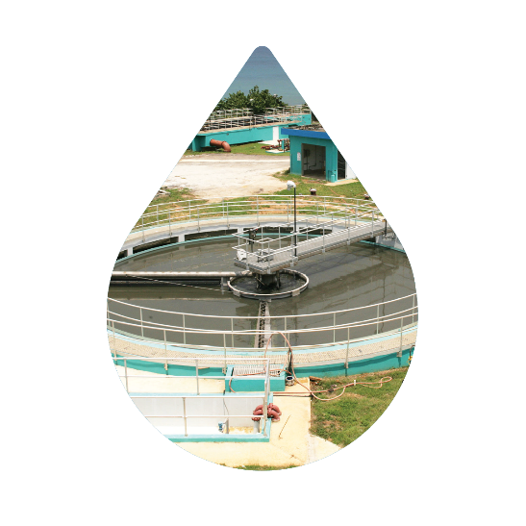
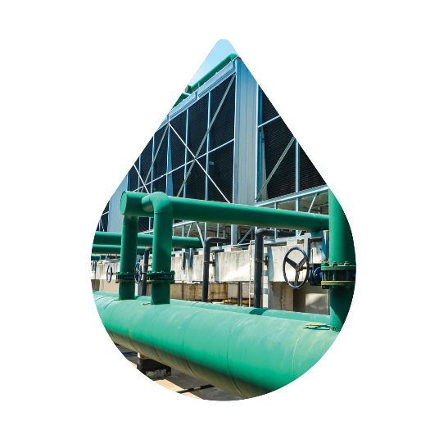
  Nuestra Autoridad
SIRVIENDO
1,266,845 CLIENTES
(96% POTABLE / 59% SANITARIA)
3,535 SQUARE MILES
4,451 EMPLEADOS
En 5 REGIONES
Misión:
Brindar un servicio de agua y alcantarillado de alta calidad, seguro, confiable, accesible al pueblo de Puerto Rico, protegiendo su salud y el medio ambiente.
Visión:
Convertir a la AAA en una empresa de servicio público de excelencia, al tiempo que supera continuamente las expectativas de los clientes y garantiza una administración sustentable de los recursos de agua de la isla.
8 REPRESAS
112 PLANTAS DE FILTRO with 136 tomas de agua
50 PLANTAS DE ALCANTARILLADO SANITARIO
SOBRE 3,800 FACILIDADES AUXILIARES, INCLUYENDO:
TANQUES – 1,574
ESTACIONES DE BOMBA– 1,978
POZOS - 244
SOBRE 21,000 MILLAS DE TUBERÍA
Potable y Sanitaria
¹Preliminary data as of September 30, 2024

Slide 3


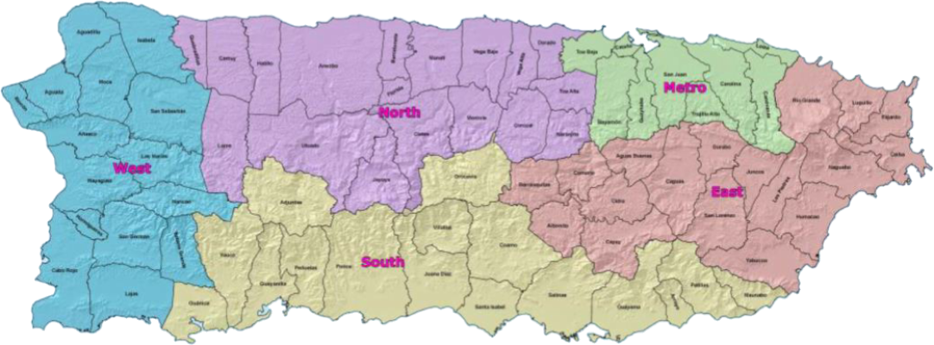
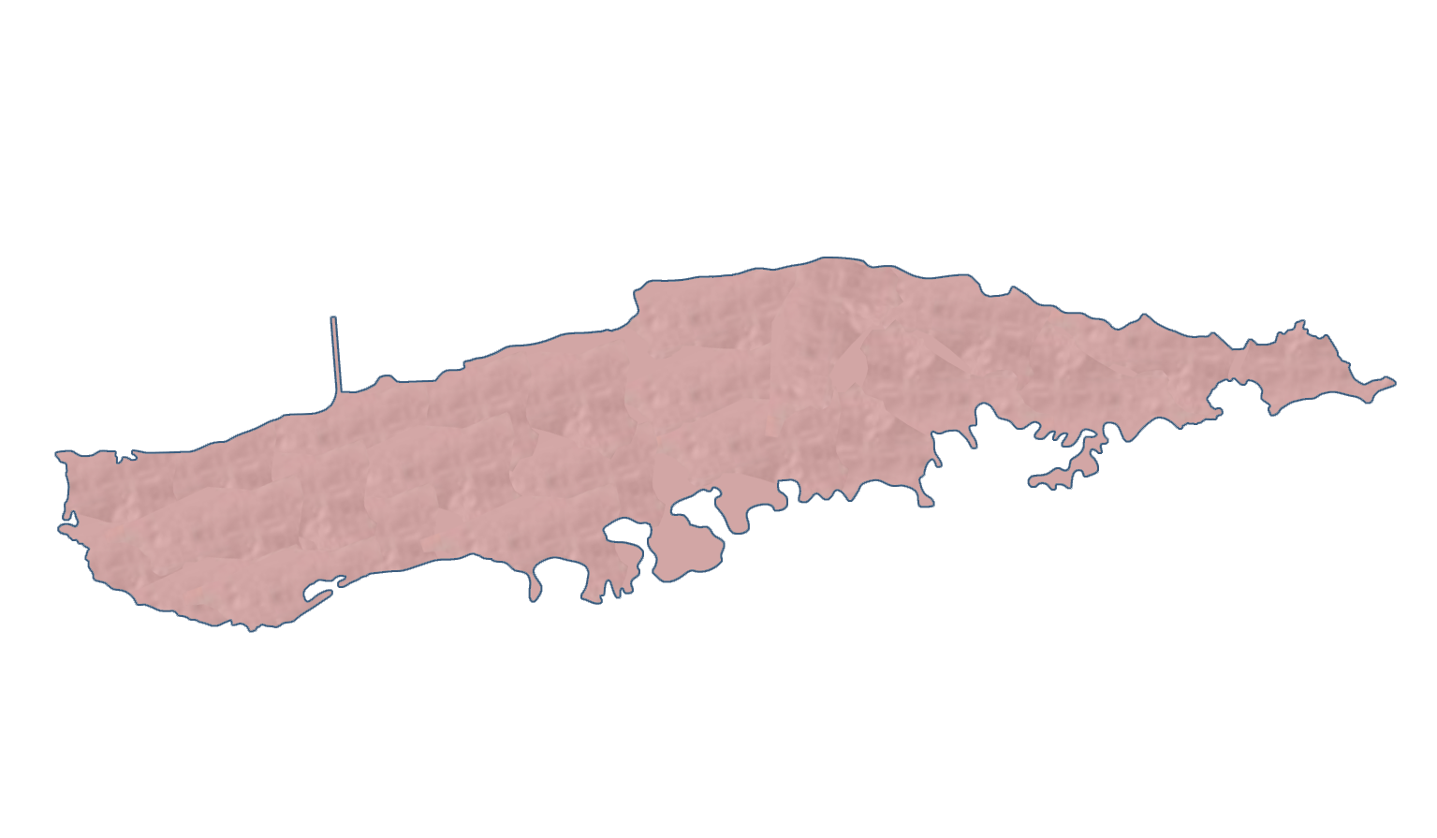
  Proyectos de Agua Potable y Alcantarillado
Agosto 31 , 2025
> 500 Proyectos
$
> $ 11.1 B Total Inversión Programa
Tipos de Proyectos
Edificios y Estructuras
Sistemas de Acueductos
Plantas de Agua Potable
Sistema de Alcantarillado
Plantas de Agua Sanitaria
$
$7.89 B Total Costos de Inversión
334 Proyectos Activos en 641 localidades

Slide 4






Un Vistazo del Programa
Número de Proyectos y Costos de Inversion por Fases
Agosto 31, 2025
$7,898 M en 334 Proyectos activos gerenciados por PMC
$2,628 M en 51 Proyectos en planificaciónón
$2,347 M en 64 Proyectos en Diseño
(28 WTP - 8 WWTP)
$518 M en 31 Proyectos en Subasta
$1,946 M en 105 Proyectos en Construcción
$459 M in 84 Proyectos en Cierre

Slide 5
Evolución del Programa de Mejoras Capitales FY 21-25
$776 M
$2,915 M
$4,068 M
$6,193 M
$7,323 M
77 Proyectos
225 Proyectos
233 Proyectos
291 Proyectos
314 Proyectos
FY 2021
FY 2022
FY 2023
FY 2024
FY 2025

Slide 6
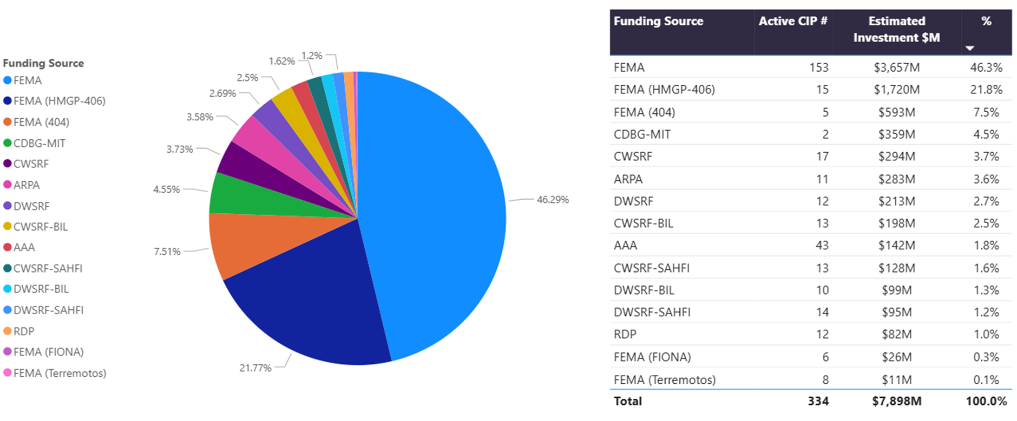
Fuentes de Financiamiento
As of FY 2026

Slide 7
SUBASTAS
August 2025

Slide 8

Anuncios de Subasta – Logros
Desde marzo 2021 a julio 2025
207 Anuncios
2021 - 40 Proyectos
$ 202 M
Costo de construcción
2024 - 50 Proyectos
$ 1,330 M
Costo de construcción
+31 Rebid
TOTAL: 207 Proyectos
$ 3,225 M
Costo de construcción
+53 Rebid
2022 - 48 Proyectos
$ 709 M
Costo de construcción
2025 - 6 Proyectos
$ 105 M
Costo de construcción
+5 Rebid
2023 - 63 Proyectos
$ 879 M
Costo de construcción
+17 Rebid

Slide 9
Status de las Subasta a September 2, 2025
Hay28 proyectos en 28 procesos de subastas
Subastas Canceladas
Anuncios de Subasta
(BID-0)
5
Reunión pre-subasta
(BID-15)
2
Apertura de Subasta
(BID-35)
12
Evaluación de Subasta
(BID-50)
7
Otorgamiento Subasta
(BID-100)
4
Otorgamiento Contrato
(CTR-100)
3

Slide 10
Upcoming Bids Advertisement (BID-0)
 | CIP | Bid Number | Project Name | PMC | Funding | Construction Cost | Bid Advert. Date
1 | 1-11-5066 | TBD | Improvement to Sanitary Trunk Sewer Van Scoy | Jacobs | CWSRF-BIL, CWSRF-SAHFI | $4,499,000 | 30-Sep-25
2 | 1-72-6043 | TBD | Rehabilitación de la PF Sergio Cuevas (FAAST) | Jacobs | FEMA, CDBG-DR | $105,227,850
3 | 2-00-9006 | TBD | D&B Emergency Generators - Wastewater - North Region - Phase V | Jacobs | CWSRF-SAHFI | $5,000,000
4 | 2-00-9007 | TBD | D&B Emergency Generators - Drinking Water - North Region - Phase V | Jacobs | CWSRF-SAHFI | $2,500,000
5 | 2-07-9006 | TBD | Rehabilitation of Radioville SSS | Arcadis | CWSRF | $6,787,124
Bids waiting for Pre-Bid Meeting (BID-15)
 | CIP | Bid Number | Project Name | PMC | Funding | Construction Cost | Pre-Bid Date
1 | 4-00-9006 | 26-SP-003 | D&B Emergency Generators – Wastewater - South Region - Phase V | Jacobs | CWSRF-SAHFI | $4,127,500.00 | 17-Sep-25
2 | 3-27-9001 | 26-SP-004 | Rehabilitación Switchgear PAS Fajardo (FAAST) | B&V | FEMA, CDBG-DR | $10,843,075 | 12-Sep-25

Slide 11
Bids waiting for Bid Opening (BID-35)
 | CIP | Bid Number | Project Name | PMC | Funding | Construction Cost | Plan Date | Rescheduled Date
1 | 2-38-6057 | 25-SP-010 | Rehabilitación Represa y Estación Bombas Aguas Crudas PF Jayuya Urbano (FAAST) | CSA | FEMA, CDBG-DR | $9,070,000 | 22-Oct-24 | 16-Sep-25 | -329
2 | 4-29-9000 | 25-SP-029 | Reh. de varios segmentos Sistema A/S Barriada La Esperanza (FAAST) | B&V | FEMA, CDBG-DR | $6,747,186 | 21-Aug-25 | 16-Sep-25 | -26
3 | 1-66-5111 | 25-MAE-I-001 | Puerto Nuevo Regional WWTP Grit System | Arcadis | CWSRF | $42,316,928 | 29-May-25 | 18-Sep-25 | -112
4 | 1-00-9008 | 25-SP-025 | D&B Emergency Generators - Wastewater - Metro Region - Phase V | Jacobs | CWSRF-SAHFI | $4,329,800 | 14-Aug-25 | 23-Sep-25 | -40
5 | 1-00-9005 | 25-SP-026 | D&B Emergency Generators - Drinking Water - Metro Region - Phase V | Jacobs | DWSRF-SAHFI | $2,457,600 | 14-Aug-25 | 23-Sep-25 | -40
6 | 4-57-6002 | 25-SP-022 | Rehabilitación de la PF Peñuelas (FAAST) | Arcadis | FEMA, CDBG-DR | $14,195,579 | 13-Feb-25 | 23-Sep-25 | -222
7 | 3-00-5019 | 25-SP-027 | D&B Emergency Generators - Wastewater - East Region - Phase V | Jacobs | CWSRF-SAHFI | $4,214,400 | 19-Aug-25 | 25-Sep-25 | -37
8 | 3-00-5020 | 25-SP-028 | D&B Emergency Generators - Drinking Water - East Region - Phase V | Jacobs | DWSRF-SAHFI | $2,487,400 | 19-Aug-25 | 25-Sep-25 | -37
9 | 3-15-6094 | 24-SP-068 | Nueva Toma para la PF Yunque (Mameyes) (FAAST) | B&V | FEMA, CDBG-DR | $21,159,333 | 18-Jul-24 | 2-Oct-25 | -441
10 | 5-48-9001 | 24-SP-075 | Rehabilitación de la Toma de Aguas Crudas PF Monte del Estado (FAAST) | CSA | FEMA, CDBG-DR | $9,210,000 | 20-Aug-24 | 2-Oct-25 | -408
11 | 3-10-6106 | 26-SP-002 | Rehabilitación de la PF Barrancas y la Toma (FAAST) | CSA | FEMA, CDBG-DR | $20,420,000​ | 16-Sep-25 | 16-Oct-25 | -30
12 | 4-00-9007 | 26-SP-001 | D&B Emergency Generators - Drinking Water - South Region - Phase V | Jacobs | DWSRF-SAHFI | $2,466,500 | 11-Sep-25 | On Track

Slide 12
Bids waiting for Bid Award (BID-100)
 | CIP | Bid Number | Project Name | PMC | Funding | Construction Cost | Bid Evaluation Date | Bid Award Plan Date
1 | 0-99-8220 | 25-SP-013 | Design and Build for the Rehabilitation of Sanitary Sewer System Phase I Metro Region | Jacobs | CWSRF | $3,325,071 | 3-Jul-25 | 12-Aug-25 | -21
2 | 3-13-5065 | 24-RFP-004 | Troncal Sanitaria Aguas Buenas - Caguas Fase III | B&V | CWSRF | $23,360,963 | 13-Aug-25 | 22-Sep-25 | 20
3 | 1-66-5104 | 24-SP-061 | Relocation of Rexach at Caño Martí Peña | Arcadis | CWSRF | $12,368,646 | 27-Aug-25 | 6-Oct-25 | 34
4 | 2-24-6116 | 25-SP-015 | Rehabilitación de la PF Negros (FAAST) | Arcadis | FEMA, CDBG-DR | $31,578,125 | 27-Aug-25 | 6-Oct-25 | 34
Bids waiting for Contract Award (CTR-100)
 | CIP | Bid Number | Project Name | PMC | Funding | Construction Cost | Bid Award date | Cont. Award Plan date
1 | 3-18-6003 | 25-SP-004 | Rehabilitation of Farallón WTP and Raw Water Intake (FAAST) | CSA | FEMA, CDBG-DR | $34,714,100 | 25-Jun-25 | 4-Aug-25 | -14
2 | 3-13-6012 | 25-SP-012 | Rehabilitation of the Caguas Norte Water Filtration Plant (FAAST) | CSA | FEMA, CDBG-DR | $96,816,000 | 16-Jul-25 | 25-Aug-25 | 7
3 | 2-54-5017 | 25-SP-017 | Construcción de nueva Subestación Eléctrica de 38KV y "Offsite" Eléctrico con nuevo punto de conexión (POC) | Jacobs | AAA | $3,802,220 | 24-Jul-25 | 2-Sep-25 | 15

Slide 13
Proyectos Relevantes
Agosto , 2025

Slide 14
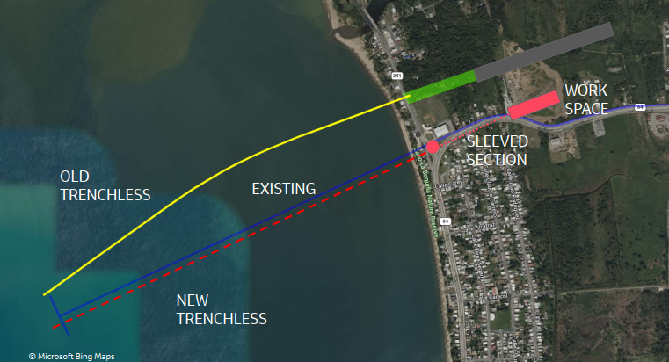
  Projects Status
CIP 5-50-9105
Mayagüez Outfall (FAAST)
Region : West Region
PMC : B&V
Designer : | Jacobs
Bid Announcement | May 27
Investment: | $100,000,000
Project Status: | Design 10%
Project Description
In September 2017 Hurricane Maria caused substantial damage to the Mayagüez RWWTP marine Outfall and Diffuser. In February 2018, an offshore diver inspection of the Outfall and Diffuser found that the Outfall pipeline breached at approximately one-third of the Outfall length offshore and there were also damages to the Outfall's Diffuser. The pipe breaches were located as two large surface “boils” (visually apparent surfacing of the Outfall effluent at the sea surface) that were observed offshore over the Outfall pipe alignment. Subsequent offshore surveys of the Mayagüez Outfall pipeline using multibeam sonar, divers, and other methods defined the nature and extent of the Outfall pipeline damages. These post-hurricane survey documented that the existing 60-inch-diameter concrete cylinder pipe installed on pile supports had failed and could not be repaired because of the extent of the damage. PRASA has engaged Jacobs Engineering Group and PMC (Jacobs Caribe Engineers PSC) to develop the Outfall Replacement Project for the Mayagüez RWWTP to meet the following main objective, development of the engineering design to replace the existing damaged Outfall and Diffuser. The design should apply the geotechnical and geophysical data that documents subsurface seabed conditions along the existing Outfall route to allow feasible and cost-effective construction while or minimizing potential future hurricane damage.

Slide 15
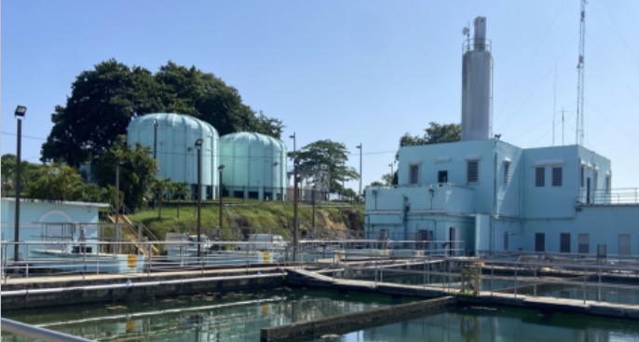
  Projects Status – Priority Project
CIP 1-01-6095
Rehabilitation of WTP Guaynabo
Region : Metro
PMC : Jacobs
Designer : | ECR Engineering LLC
Bid Announcement : | Apr 2026
Investment: | $90,000,000
Project Status: | Design 30%
Project Description
Guaynabo Water Treatment Plant (WTP) was built in 1924 and has a design capacity of 25 million gallons per day (MGD), it receives raw water from two sources, the Bayamón and Guaynabo rivers through the Santa Rosa Intake and Aguas Buenas Lake Intake. The WTP is exposed to aggressive environmental conditions due to the water treatment process and its location within an urban area. Several existing components of the WTP need to be replaced or improved. In summary, some of the necessary improvements are the following: rehabilitation of to the Sludge Treatment System including a new Washwater Treatment System, new Holding Tank and New Gravity Thickener, replacement of the Sedimentation Basins’ Entrance Channel Roof, replacement of Underdrains of the eighteen (18) Filters, replacement of Filters’ Media, replacement of Spyder System in the Sedimentation basins, new Security System, new MCC, and general and architectural improvements to the WTP's buildings.

Slide 16
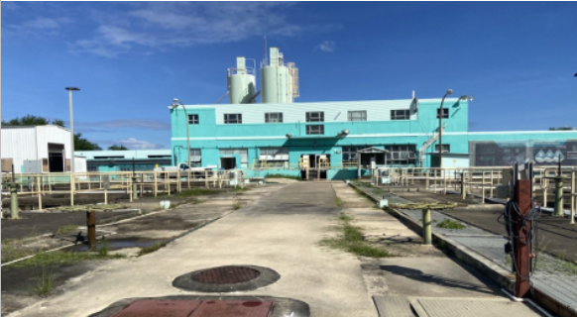
  Projects Status
CIP 1-72-6043
Rehabilitation of WTP Sergio Cuevas
Preconstruction Region Metro
Designer: | Luis Hernandez & Associates
Bid Announcement: | Sept 25
Investment: | $112,594,806
Construction Cost: | $105,227,850
Project Status: | Design 90%
Project Description
Rehabilitation to the existing processes components, Sludge Treatment System, and general restoration of the WTP. Process improvements comprise rehabilitation or replacement of the sludge treatment system in the sedimentation basins, rehabilitation of underdrains in the filters, replacement of filter media, additional units for the STS system, replacements of pumps for the various process around the WTP. Rehabilitation of buildings, roof impermeabilization, corrosion treatment to concrete and metal components.

Slide 17
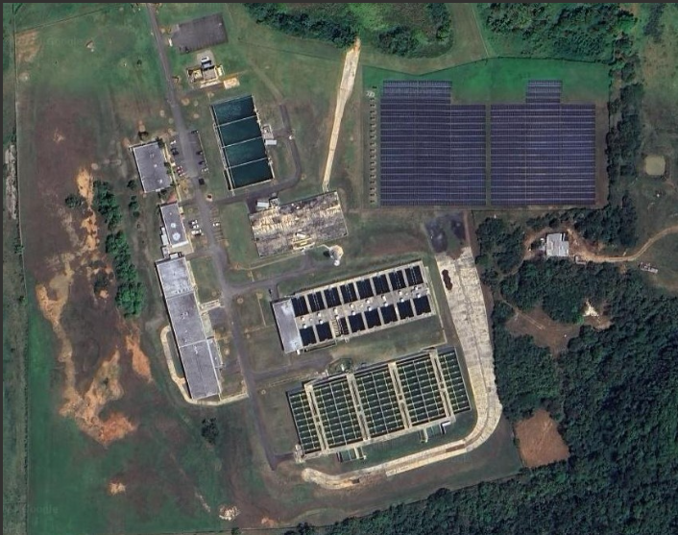
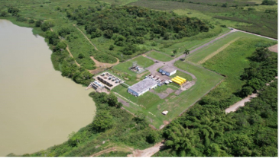
  Projects Status
CIP 2-91-6002
Superaqueduct WTP
CIP 1-07-6003
Superaqueduct Microgrid
Region : Metro
PMC : Jacobs
Region : Metro
PMC : Arcadis
Designer : | Arcadis Caribe
Bid Announcement : | Sep 26
Investment: | $125,000,000
Project Status: | Design 30%
Designer : | HD Group LLC
Bid Announcement : | Sep 26
Investment: | $97,569,268
Project Status: | Design 30%
Project Description
The Superaqueduct (Santiago Vázquez) WTP facility treats surface water, drawn from the Dos Bocas and Lago Caonillas reservoirs. The project objective is to upgrade the existing facility in accordance with latest codes and standards to ensure resiliency and utilization latest industry standards. Evalute expansion of the treatment facility to address high water demand and eliminate the facility operations over its design capacity.
A Power Microgrid solution for the Superaqueduct RWI located in the municipality of Arecibo. The RWI pump station peak power in a one (1) year period was 7.883MW. The design of shall consider a combination of the following technologies: Photovoltaic System, Battery Energy Storage System (BESS), Wind Turbines, and/or Prime Power Generator fueled by Liquefied Natural Gas (LNG) or Liquefied Petroleum Gas (LPG).

Slide 18
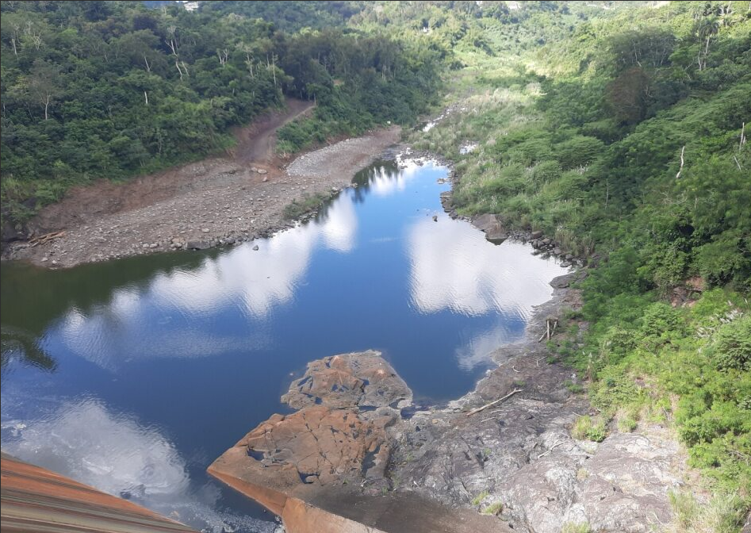
  Projects Status
CIP 1-70-9000
Enrique Ortega/La Plata WTP - Raw Water Intake Power Generator
Preconstruction Region Metro
Designer: | CSA Architects & Engineers, PSC
Construction Start: | Sep 25
Investment: | $39,805,169
Construction Cost: | $30,122,536
Project Status: | Contract Signed
Project Description
The purpose of the Enrique Ortega Water Treatment Plant (WTP) Raw Water Intake Power Generator Project's 1st Phase is to provide backup power to the Enrique Ortega WTP at La Plata Lake Dam in order to enable the continued supply of safe drinking water to more than 369,000 people in the event of a power outage. The scope of work includes providing engineering design, construction drawings, permits, and land surveying for the installation of four 2,500 KW generators to provide backup power to the Raw Water Intake Pump Station, sump pump, dam gate system engine, office building, exterior lighting, and security systems. The existing generators, which only power part of the dam's facilities, could be replaced with the proposed generators. The proposed site for the generators is approximately 200 meters from the pump control building facilities and would be connected both underground and aboveground. A 1,800 square meter parcel would be acquired for the generator site, and an additional 6,450 square meters are required for the access road right-of-way.

Slide 19
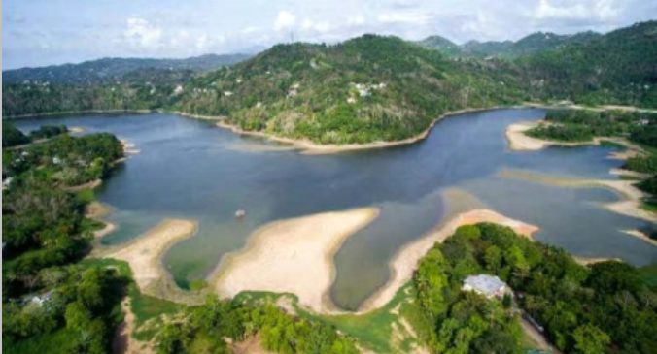
  Projects Status
CIP 1-00-9002
Lago Loíza (Carraízo) Sediment Management
Preconstruction Region Metro
Designer : | HBC Engineering
Bid Announcement : | Dec 25
Investment: | $90,773,063
Construction Cost: | $73,800,000
Project Status: | Planning 100%
Project Description
The Carraízo Dam and Reservoir are located on Rio Grande de Loíza in eastern Puerto Rico. The dam (18.3282, -66.0158) is approximately 22 km upstream from the Atlantic Ocean and San Juan in the municipality of Trujillo Alto; the reservoir (18.3156, -66.0212) is in the municipalities of Trujillo Alto, Gurabo, and Caguas. Downstream of the Dam, Rio Grande de Loíza passes through the municipalities of Trujillo Alto, Carolina, Canóvanas, and Loíza. The Carraízo Dam and Reservoir serve the Sergio Cuevas Water Filtration Plant (WFP) in Trujillo Alto. The Puerto Rico Aqueduct and Sewer Authority (PRASA) is proposing a cost-effective 406 Hazard Mitigation (HM) solution to protect the Federal Investment associated to Project Carraízo Reservoir Dredging. The HM solution consists of upgrades to the Carraízo Dam Infrastructure to facilitate reservoir drawdown during sluicing events and the implementation of nature-based solutions (NBS) to reduce sediment loads delivered to Lago Loíza (Carraízo) Reservoir from upstream tributaries.

Slide 20
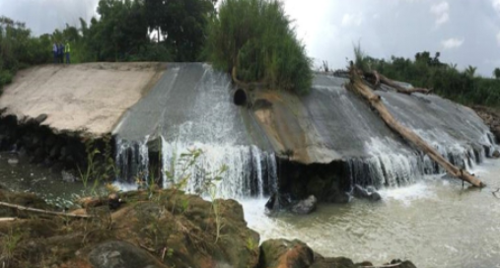
  Projects Status
CIP 1-11-6008
Improvements to the Santa Rosa Raw Water Intake
Preconstruction Region Metro
Designer : | GLM Engineering PSC
Bid Announcement : | Apr 26
Investment: | $61,752,976
Construction Cost: | $51,054,392
Project Status: | Design 90%
Project Description
Santa Rosa Intake is located at the intersection of the Guaynabo and Bayamon Rivers. A downstream dam impounds the water to maintain a water level and allow a constant raw water extraction. The Dam has suffered erosion and needs rehabilitation or replacement. The Pump Station needs improvements and surge protection equipment. Santa Rosa Intake Improvements: replacement of the three existing pumps (1 pump@10 MGD and 2 pump@5 MGD) with 2 pumps @10 MGD and 1 pump @5 MGD, rehabilitation of the existing dam, relocation of Santa Rosa Intake, relocation of Electrical Sub-station, MCC and Generators, replacement of existing 30-inch raw water pipeline, new MCC, and rehabilitation of buildings, roof impermeabilization, and painting.

Slide 21
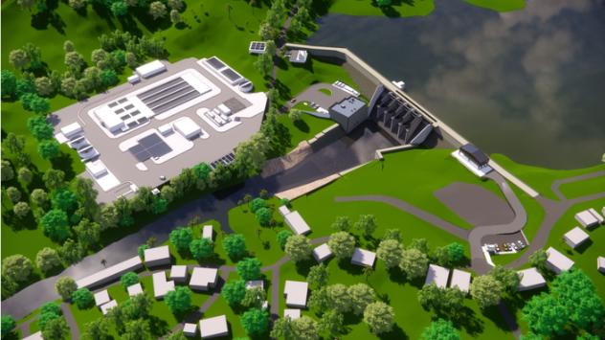
  Projects Status – Priority Project
CIP 3-40-5007
Dam and Water Intake Valenciano
Región : Este
Diseñador : | CSA Louis Berger
Costo Inversión: | $154,600,000
Bid Announcement: | Oct 26
Estatus: | Diseño 30%
Descripción
El Proyecto de Mejoras al Sistema de Abastecimiento de Agua de la Región Este (Valenciano) propone la construcción de un nuevo embalse con una capacidad de 12.7 millones de metros cúbicos. El proyecto permitirá a la AAA proveer un servicio de agua potable confiable y seguro a los municipios de Juncos, San Lorenzo, Las Piedras y Gurabo, además de los barrios Tejas, Mabu, Collores y Mambiche de Humacao, y el barrio Tomás de Castro de Caguas. La Represa Valenciano se propone como una represa de gravedad en concreto compactado con rodillo de 38.5 metros de altura, con 310 metros de ancho total (longitud de coronación), un vertedero principal de 66 metros de ancho, y una serie de sistemas de compuertas y torres de desagüe para manejar la sedimentación y controlar la toma de agua cruda. La infraestructura aguas abajo propuesta incluye un cuenco amortiguador (stilling basin) de 31 m de largo por ~50 m de ancho promedio, así como muros guía y muros de contención a lo largo del disipador de energía y la transición hacia el cauce del río.

Slide 22
  Projects Status – Priority Project
CIP 1-11-6008
Improvements to the Santa Rosa Raw Water Intake
Preconstruction Region Metro
Designer : | GLM Engineering PSC
Bid Announcement : | Apr 26
Investment: | $61,752,976
Construction Cost: | $51,054,392
Project Status: | Design 90%
Project Description
Santa Rosa Intake is located at the intersection of the Guaynabo and Bayamon Rivers. A downstream dam impounds the water to maintain a water level and allow a constant raw water extraction. The Dam has suffered erosion and needs rehabilitation or replacement. The Pump Station needs improvements and surge protection equipment. Santa Rosa Intake Improvements: replacement of the three existing pumps (1 pump@10 MGD and 2 pump@5 MGD) with 2 pumps @10 MGD and 1 pump @5 MGD, rehabilitation of the existing dam, relocation of Santa Rosa Intake, relocation of Electrical Sub-station, MCC and Generators, replacement of existing 30-inch raw water pipeline, new MCC, and rehabilitation of buildings, roof impermeabilization, and painting.

Slide 23
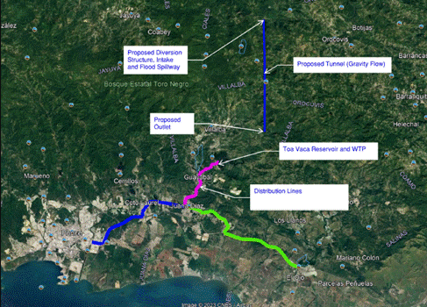
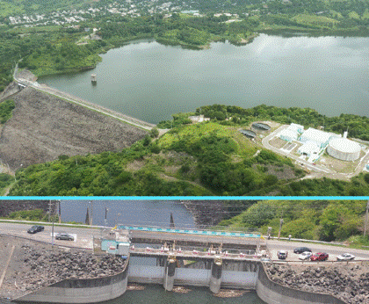
  Projects Status – Priority Project
CIP 4-00-9000
Bauta Tunnel
Region : South
PMC : Jacobs
Designer : | Black & Veatch
Bid Announcement : | Mar 27
Investment: | $257,406,750
Project Status: | Planning
Project Description
PRASA’s South Region Water Supply System Improvement Project includes three (3) main components, one of which proposes to connect the Toa Vaca watershed basin to a watershed basin located on the north side of the Island via a tunnel. The construction of the Bauta Tunnel intends to supplement the inflow of the Toa Vaca Reservoir in Villalba by connecting the Bauta River basin in Orocovis to the existing Toa Vaca watershed traversing the central mountainous range of the island. The intent of the project is to increase the water supply reliability for the southern region of Puerto Rico and help restore the aquifers in the south by ceasing the extraction of water from groundwater wells.

Slide 24
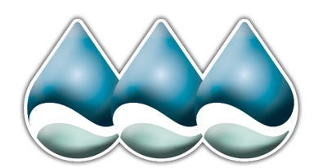

GRACIAS POR SU ATENCIÓN
PREGUNTAS
?
?

