Slide 1
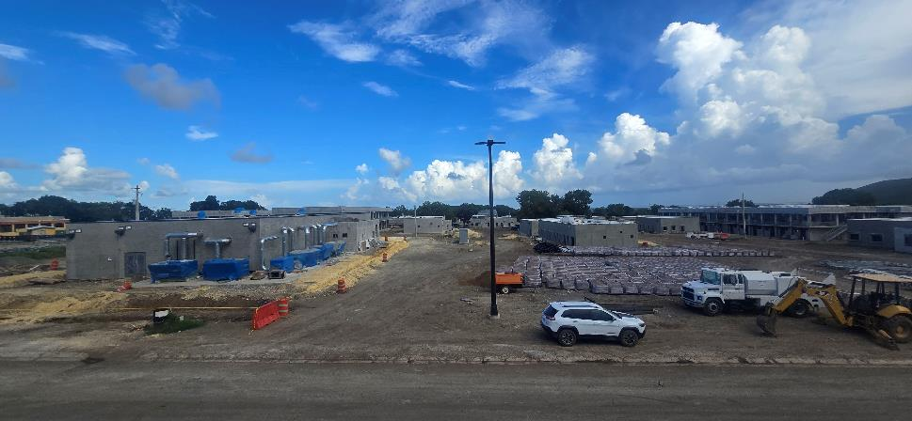
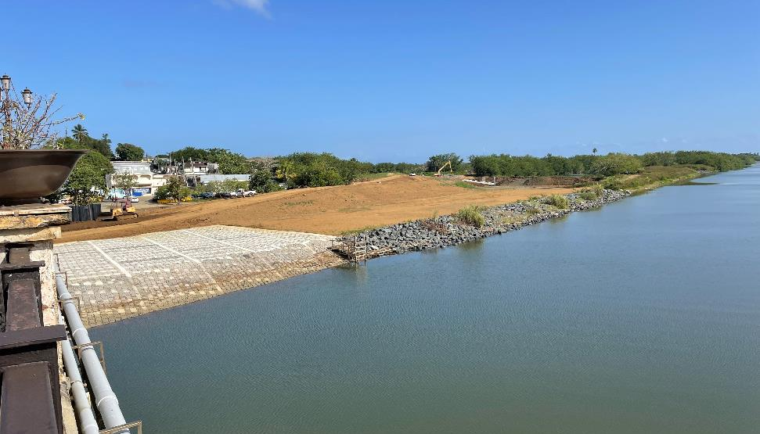

U.S. Army Corps of engineers
Caribbean District
“Recomendaciones para fomentar la participación de contratistas y empresas locales en los proyectos de USACE”
Date: 5 September 2025
Presented by:
Maricarmen Crespo, P.E.
Chief of Construction
Mariano Torres Feliciano
Chief, Small Business Division
PRARNG Camp Santiago Joint Training Center
Rio de La Plata, Dorado Bridge and ACBM Toe Key Construction

Slide 2

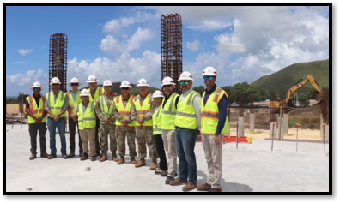
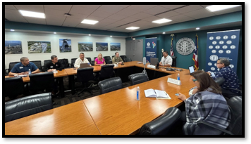
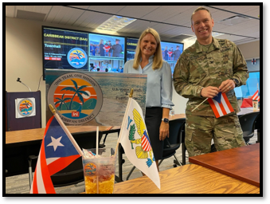
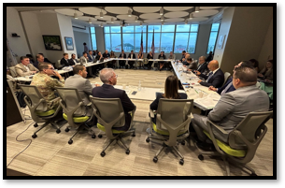
Evolution of A DISTRICT
Jacksonville District
Antilles Office & Integrated Project Office (IPO)
Task Force
Virgin Islands Puerto Rico (VIPR)
Caribbean District
Initial Operating Capability (IOC)
Caribbean District
Full Operating Capability (FOC)
2021 – April 2023
April 2023 – July 2024
July 2024 – July 2025
July 2025 –

Slide 3

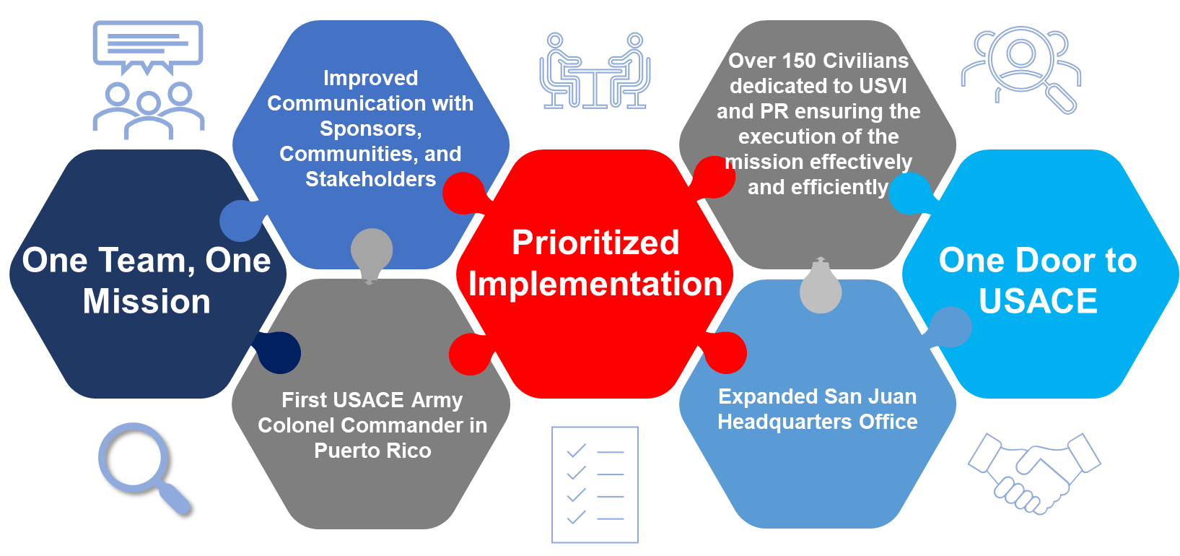
Caribbean District
Provides additional leadership bandwidth and focus on priority missions in U.S. Virgin Islands, Puerto Rico, and Greater Antilles

Slide 4
District capabilities
Civil Works
Flood Risk Management
Navigation
Coastal Storm Risk Management
Ecosystem Restoration
Military Construction
DOD Support
US Army Reserve
PR National Guard
USVI National Guard
International & Interagency Support
PREPA Support: Water Assets, Dams, Hydropower, irrigation
FDA San Juan Campus
SOUTHCOM
Regulatory
Section 10 Rivers and Harbors Act
Section 404 Clean Water Act
Emergency Management
Stafford Act emergency assistance under FEMA: Temporary Power, Temporary Roofing (Blue Roof), Infrastructure Assessments, Debris Removal, Flood Risk Management
Public Law 84-99

Slide 5

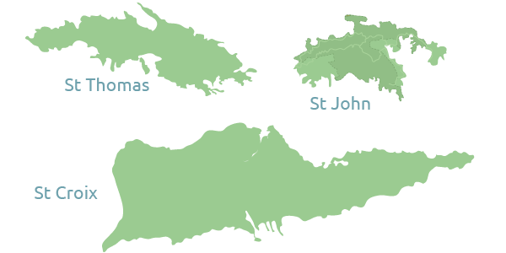
Caribbean district programs
Civil works, regulatory, MILitary, and interagency and international services, Emergency management
Arecibo Harbor
San Juan Harbor
San Juan Metro
Fort Buchanan
Ramey
Rio Grande
de Arecibo
Rio Culebrinas
Rio de la Plata
Rio Puerto Nuevo
Caño Martin Peña
Rio Grande
de Manati
BONUS Site
Puerto Nuevo USAR Solar Array
Guajataca Dam
Mayaguez Harbor
Puerto Rico
Rio Guanajibo
Rio Aibonito
GuayabalDam
Fort Allen
Camp Santiago
Rio Guayanilla
Ponce
U.S. Virgin Islands
Patillas Dam
Rio Nigua
Deep Draft Navigation
Ponce Harbor
Flood Risk Management
Savan Gut
Vehicle Maintenance Shop
Charlotte Amalie Harbor
Aquatic Ecosystem Restoration
Turpentine Run
Coastal Storm Risk Management
Christiansted
Harbor
Interagency and International Services (IIS)
Estate La Grande
Military Construction (MILCON) & Installation Readiness
Civil Support Facility
*Regulatory (PR and USVI Jurisdiction)

Slide 6
CIVIL WORKS PROGRAM |  |  | MILITARY CONSTRUCTION & INTERAGENCY & INTERNATIONAL SERVICES ( IIS ) PROGRAM
INVESTIGATIONS | DESIGN AND CONSTRUCTION | OPERATIONS & MAINTENANCE | MILITARY CONSTRUCTION (MILCON) | INSTALLATION READINESS
Rio Nigua Validation Report | Aquatic Ecosystem Restoration (AER) | San Juan Harbor O&M (Nav-BIL)​ | FTB: Army Family Housing​ | PRARNG: Camp Santiago Ammunition Supply Point​
SMALL PROJECTS PROGRAM | Caño Martin Pena (AER-IIJA) | Arecibo O&M (Nav-BIL)​ | PRARNG: Camp Santiago Barracks​ | PRARNG: Soil Sampling Bldg 563
Continuing Authorities Program (CAP) | Flood Risk Management (FRM) | Ponce Harbor O&M (Nav-BIL)​ | PRARNG: Camp Santiago DFAC ​ | DODEA: PA System Upgrades (FTB and Ramey Schools)
Rio Aibonito FRM | Rio de la Plata (FRM – BBA 2018)​ | Mayaguez Harbor O&M (Nav-BIL)​ | PRARNG: Camp Santiago HQ​ | DODEA: Ramey Electrical Repairs
Floodplain Management Services (FPMS) | Rio Grande de Arecibo (FRM – BBA 2018)​ | Inspection of Completed Works, PR & USVI​ | PRARNG: Fort Allen Readiness Center​ | FTB: RWH Systems Maintenance
Ponce FPMS | Rio Puerto Nuevo (FRM – BBA 2018)​ | Project Condition Surveys, PR & USVI​ | VIARNG: STT Vehicle Maintenance Shop​ | FTB: Sanitary Sewer Study
Planning Assistance to States (PAS) | Rio Guanajibo (FRM – BBA 2018)​ |  | VIARNG: STX Civil Support Facility​ | ENVIRONMENTAL
USVI Compound Flooding Hotspots | Rio Nigua (FRM – BBA 2018)​ |  | ERCIP: MCA - FY-20 Puerto Nuevo USAR Solar Array​ | FTB: Old AES MOA
Ponce FPMS | Rio Grande de Manati (FRM - DRSAA)​ |  | INTERNATIONAL SERVICE * | INTERAGENCY SERVICE *
PR Dam Safety | Rio Culebrinas (FRM - DRSAA)​ |  | DOMREP: Rare Earth Elements | PREPA: Guajataca Dam Permanent Repairs
Interagency Non-structural FPMS | Rio Guayanilla (FRM - IIJA)​ |  | US Embassy Barbados: Dominica Material Testing Lab | PREPA: Patillas Dam Seismic Retrofit Pre-Award Support
PR Watersheds | Savan Gut (FRM - IIJA)​ |  |  | PREPA: Technical & Management Services
PR All Hazards | Turpentine Run (FRM - DRSAA) |  |  | DOE-LM: BONUS Site, Rincon
PR Dam Safety | Continuing Authorities Program (CAP)
PRE-CONSTRUCTION, ENGINEERING & DESIGN (PED) | Estate La Grange (FRM - IIJA)
Coastal Storm Risk Management (CSRM) | Navigation
San Juan Metro (CSRM)​ | San Juan Harbor Deepening (Navigation – IIJA)​
*Other agency funded
Program Value > $10 Billion

Slide 7
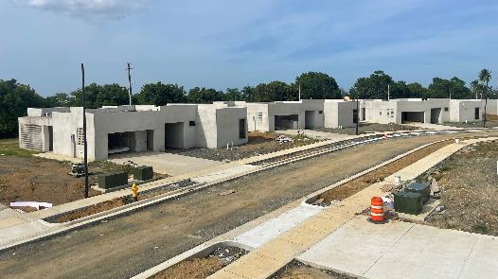
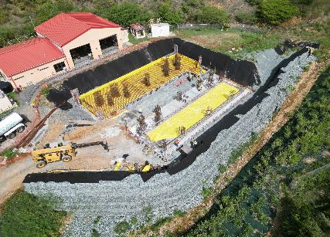
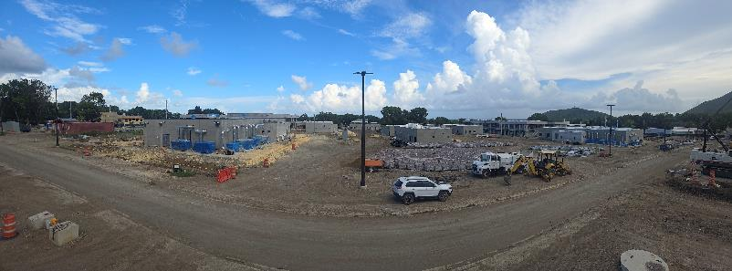
FY25 SAA MILCON / IIS active CONSTRUCTION
PROJECT | LOCATION | PROGRAM TYPE | CONTRACT AWARD | AWARD PERIOD OF PERFORMANCE | AWARD CONTRACT VALUE | CONTRACTOR
Army Family Housing Replacement | Ft Buchanan, PR | MILCON | 24-Sep-21 | 889 | $31M | Design Build, LLC
Army Reserve Energy Resilience and Conservation Investment Program (ERCIP) Puerto Nuevo | San Juan, PR | MILCON | 24-Sep-21 | 797 | $9.6M | Teksol Integration Group, Inc.
Army Reserve National Guard STT Vehicle Maintenance Shop Additions | St. Thomas, USVI | MILCON | 16-Sep-22 | 730 | $3.5M | Advantix Engineering Corp.
PR Army National Guard Joint Training Center (PRARNG JTC) | Salinas, PR | MILCON | 28-Sep-22 | 1460 | $291M | 4 Contractor JV
DoDEA - Ramey Unit School Electrical Repairs | Aguadilla, PR | MIL-O&M | 30-Sep-24 | 730 | $3.7M | Teksol Integration Group, Inc.
DoDEA Public Address (PA) Systems (Design-Build) | Multiple Locations | MIL-O&M | 30-Sep-24 | 730 | $3.8M | Teksol Integration Group, Inc.
National Park Services, San Fernando Bastion | San Juan, PR | IIS | 01-May-25 | 550 | $13.1M | NOVEL Construction, LLC

Slide 8
FY25 MILCON / IIS active CONSTRUCTION
Support for other districts
PROJECT | LOCATION | PROGRAM TYPE | CONTRACT AWARD | AWARD PERIOD OF PERFORMANCE | AWARD CONTRACT VALUE | CONTRACTOR
DoDEA Repair HVAC Antilles Middle School | Ft Buchanan, PR | MILCON | 30-Sep-22A | 540 | $3.5M | Multi Air Services Engineers, Corp.
Fort Buchanan Army Reserve Center -Operations Building | Ft Buchanan, PR | MILCON | 25-Sep-2024 | 860 | $29.6M | Conti Federal Services, LLC
Ramey ARC Microgrid | Aguadilla, PR | ERCIP | 30-Aug-24 | 610 | $16.7M | RQ-Lord JV
LTC Hernan G. Pesquera ARC Microgrid | Juana Diaz, PR | ERCIP | 30-Aug-24 | 610 | $16.9M | Parsons Government Services, Inc.
PR901 D/B Paving Aguadilla | Aguadilla, PR | MIL-O&M | 21-Sep-23 | 610 | $1.3M | Southeastern Barlovento
PR013 Window Replacement | Aguadilla, PR | MIL-O&M | 27-Sep-24 | 610 | $650K | Teksol Integration Group, Inc.
PR010 Replace Fire Pump | Juana Diaz, PR | MIL-O&M | 13-Sep-24 | 240 | $441K | Teksol Integration Group, Inc
PR012 Replace Fire Alarm |  | MIL-O&M | 30-Sep-24 | 330 | $407K | Teksol Integration Group, Inc
PR010 D/B OMS Renovation | Juana Diaz, PR | MIL-O&M | 30-Sep-24 | 420 | $1.1M | Teksol Integration Group, Inc
Legend
Jacksonville District
Louisville District
Charleston District

Slide 9
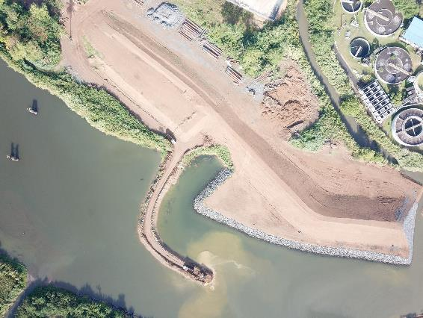
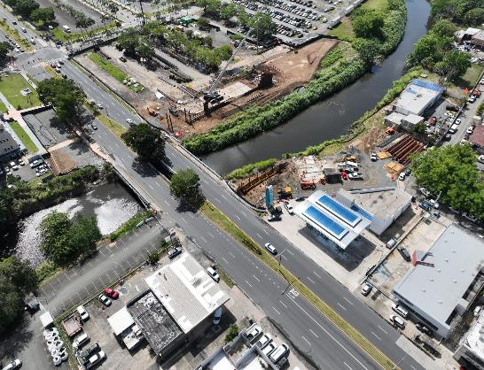
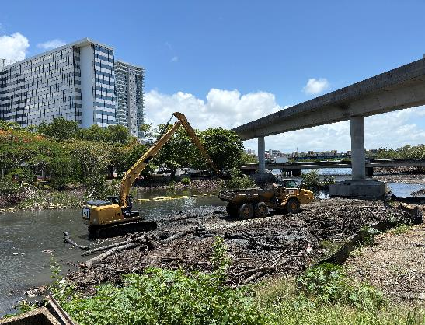
FY25 CIVIL WORKS ACTIVE CONSTRUCTION
PROJECT |  | LOCATION | PROGRAM TYPE | CONTRACT AWARD | AWARD PERIOD OF PERFORMANCE | AWARD CONTRACT VALUE | CONTRACTOR
CIVIL WORKS PROJECTS
Dorado Bridge CWSP | Dorado, PR | Dorado, PR | CIV-CONGEN | 27-Sep-17 | 1,833 | $17M | Construcciones Jose Carro, S.E.
Rio de la Plata ACBM & Toe Key | Dorado, PR | Dorado, PR | CIV-CONGEN | 12-May-20 | 797 | $11M | Construcciones Jose Carro, S.E.
Rio Puerto Nuevo CNT2 – Roosevelt Avenue Bridge Replacement | San Juan, PR | San Juan, PR | CIV-CONGEN | 9-Apr-24 | 1661 | $150.7M | Ferrovial Construction PR, LLC
Caño Martin Peña CNT2 – Western Bridges Scour Protection | San Juan, PR | San Juan, PR | CIV-CONGEN | 6-Sep-24 | 730 | $14.7M | NOVEL Construction PR, LLC

Slide 10
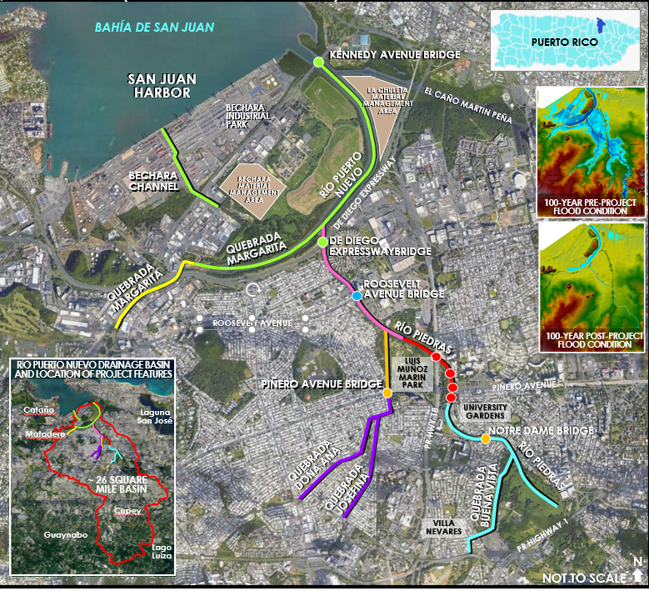
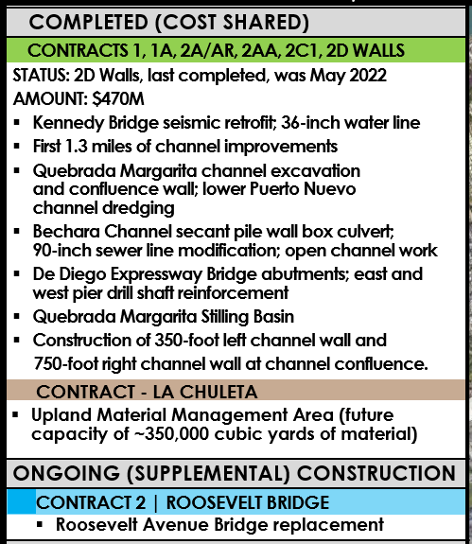
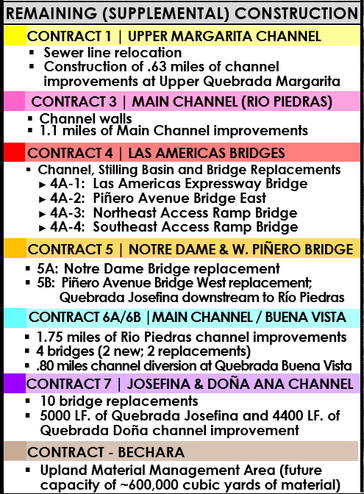
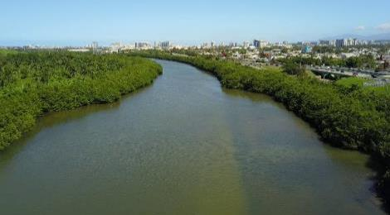
RIO PUERTO NUEVO - OVERVIEW

Slide 11
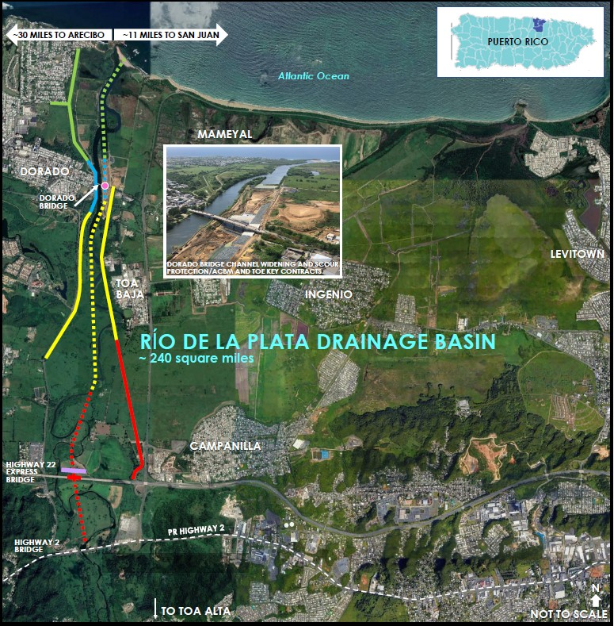
Rio de la plata - overview
PROJECT FEATURES AND IMPLEMENTATION PLAN
CONTRACT 1A
Completed 2015
Disposal Area
DORADO BRIDGE CHANNEL WIDENING AND SCOUR PROTECTION
Anticipated Completion: 2024
ARTICULATED CONCRETE BLOCK MAT AND TOE KEY
Substantial Completion: 2023
East Levee
SUPPLEMENTAL CONTRACT 1
Features
4 concrete culverts
1.6 miles of river channel improvements
2.9 miles of earthen levees
30 acres of wetland mitigation
Disposal Area
SUPPLEMENTAL CONTRACT 3
Features:
1.4 miles of river channel improvements
1.3 miles of earthen levees
East Levee
PR HWY-22
Disposal
Area
SUPPLEMENTAL CONTRACT: NORTH COAST SUPERAQUEDUCT RELOCATION
Features:
1,000-foot relocation of a 72-inch potable water line, which supplies water to the northern municipalities
PR HWY-2
Channel
PR-2 Bridge and Road Re-alignment

Slide 12
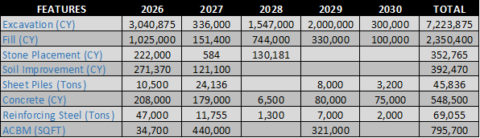
PR BIG 3 ESTIMATED QUANTITIES FOR THE MAIN SUPPLY NEEDS (Per project Award date)
Note: Projects are at different stages in the design process. Estimated quantities developed with the latest available design data.
Subject to change.

Slide 13
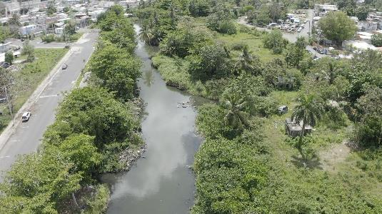
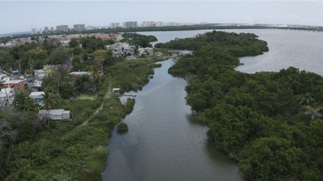
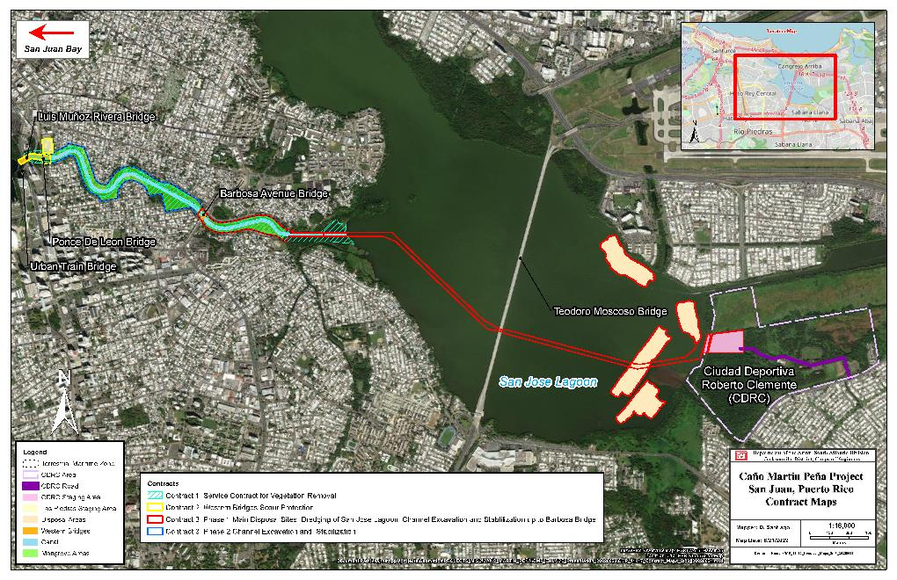
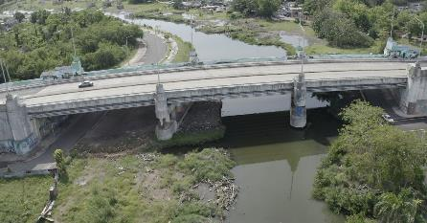
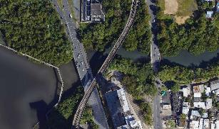
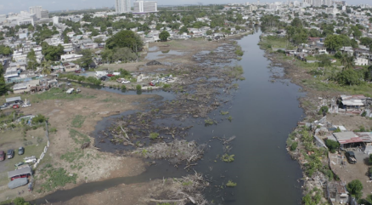
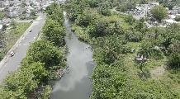
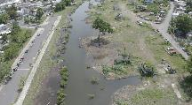
CAÑO MARTÍN PEÑA - OVERVIEW
PROJECT IMPLEMENTATION, FEATURES, AND MAP
CONTRACTS
CONTRACT 1|VEGETATION REMOVAL
STATUS: Completed June 2023, $3,4M, 36 acres vegetation removed.
SOLID WASTE REMOVAL CONTRACT
STATUS: Completed Oct 2023, $2.3M, 15K Tons removed + Modification for additional 3.8K Tons ($600K).
Barbosa
BRIDGE
Contract 3: Phase 1
CONTRACT 2 | WESTERN BRIDGES SCOUR PROTECTION. Martín Peña, Tren Urbano, and Luis Muñoz Rivera
STATUS: Awarded Sep 2024, $14.7M. Expect completion in Oct 2026
SCOPE
Excavation of ~ 25K CY of material from the western end of the channel
Construction of a 115-foot-wide by 6.5-foot-deep channel located at western bridges.
Installation of riprap at the channel bottom and the side slopes to prevent scour
Steel sheet pile walls will be installed at the eastern end
Martin Pena
BRIDGE
BARBOSA
BRIDGE
LUIS
MUÑOZ
RIVERA
BRIDGE
TREN
URBANO
BRIDGE
Contract 2
CONTRACT 3 | CHANNEL EXCAVATION / STABILIZATION
2022
STATUS: Phase 1 & Phase 2 Contracts award anticipated in Sep 2025 and Jan 2028, respectively
SCOPE
1.8 miles channel dredging
2 miles access channel dredging from staging area to eastern end of CMP
Bank stabilization to include sheet pile
Barbosa Bridge scour protection
~ 35 acres Mangrove/wetland restoration for entire channel
Recreation features
2023
Contract 3: Phase 2

Slide 14
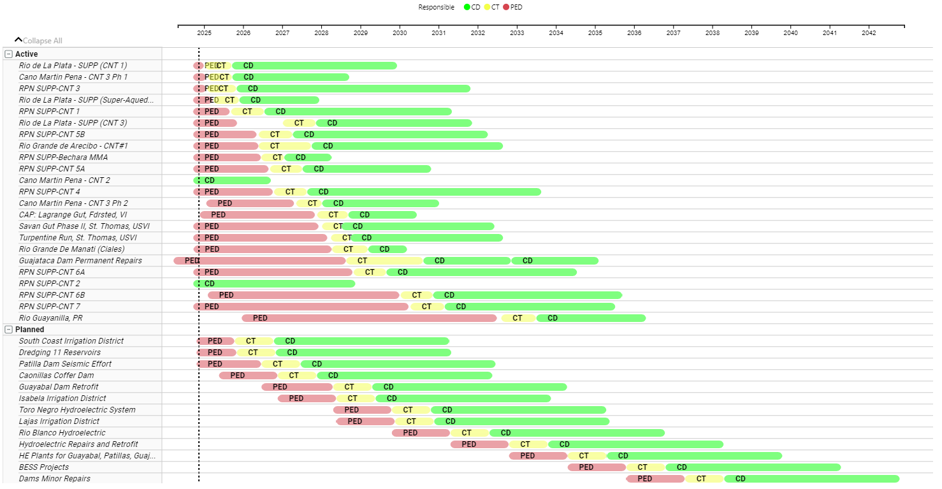
Integrated schedule
Design Acquisition/Award Construction
FY28
CIVIL WORKS:
-RPN CONTRACT 4
-CAÑO MARTIN PEÑA CNT 3, PH 2
-RGD MANATI, CIALES
-SAVAN GUT (USVI)
-ESTATE LA GRANGE (USVI)
MILITARY:
-ANTILLES MIDDLE/HIGH SCHOOL**
IIS:
-GUAYABAL DAM RETROFIT (PREPA)
-GUAJATACA DAM (PREPA/FEMA)
FY27
CIVIL WORKS:
-RPN CONTRACT 1
-RPN, BECHARA MMA
-RPN CONTRACT 5B
-RPN CONTRACT 5A
-RDLP CONTRACT 3
MILITARY:
-FORT BUCHANAN MICROGRID*
-FORT BUCHANAN LAKE LAS CASAS*
IIS:
-PATILLAS DAM (PREPA)
FY26
CIVIL WORKS:
-CAÑO MARTIN PEÑA CNT 3, PH 1
-RPN CONTRACT 3
-RPN LA CHULETA (Services)
-RDLP CONTRACT 1
-RDLP NORTH SUPER ACQUEDUCT
MILITARY:
-VING CST, ST. CROIX
-FORT BUCHANAN BARRACKS* RAMEY UNIT SCHOOL**
>$7B
>$2B
*Under continued development

Slide 15
EXPECTED construction AWARDS FY26-28
FY26
CIVIL WORKS:
-CAÑO MARTIN PEÑA CNT 3, PH 1
-RPN CONTRACT 3
-RPN LA CHULETA (Services)
-RDLP CONTRACT 1
-RDLP NORTH SUPER ACQUEDUCT
MILITARY:
-VING CST, ST. CROIX
-FORT BUCHANAN BARRACKS* RAMEY UNIT SCHOOL**
FY27
CIVIL WORKS:
-RPN CONTRACT 1
-RPN, BECHARA MMA
-RPN CONTRACT 5B
-RPN CONTRACT 5A
-RDLP CONTRACT 3
MILITARY:
-FORT BUCHANAN MICROGRID*
-FORT BUCHANAN LAKE LAS CASAS*
IIS:
-PATILLAS DAM (PREPA)
FY28
CIVIL WORKS:
-RPN CONTRACT 4
-CAÑO MARTIN PEÑA CNT 3, PH 2
-RGD MANATI, CIALES
-SAVAN GUT (USVI)
-ESTATE LA GRANGE (USVI)
MILITARY:
-ANTILLES MIDDLE/HIGH SCHOOL**
IIS:
-GUAYABAL DAM RETROFIT (PREPA)
-GUAJATACA DAM (PREPA/FEMA)
Construction support only:
*Army Reserve Program, LRL
**DoDEA Program, SAS

Slide 16
Integrated schedule
Design Acquisition/Award Construction
>$7B
>$2B
*Under continued development

Slide 17
Saa contract opportunities
CONSTRUCTION CONTRACTS
PROJECT MISSION | PROJECT NAME | MAGNITUDE OF CONSTRUCTION | ACQUISITION STRATEGY | SOLICITATION TYPE | ADVERTISE / DUE DATE
Civil Works | Caño Martin Peña (Contract 3 Phase 1) | $25M - $100M | Unrestricted | RFP – BVTO | 28 JUL 2025 / 11 AUG 2025
Civil Works | Rio de la Plata (Contract 1) | $250M - $500M | Unrestricted | RFP – BVTO | Q1 FY26
Civil Works | Rio de la Plata (Super Aqueduct) | $25M - $100M | Unrestricted | RFP – BVTO | Q1 FY26
Civil Works | Rio Puerto Nuevo (Contract 1) | $100M - $250M | TBD | RFP – BVTO | Q4 FY26
Civil Works | Rio Puerto Nuevo (Contract 5) | $250M - $500M | Unrestricted | RFP – BVTO | Q4 FY26
Soliciting between $650M to $1.7B in Construction and Service Contacts
by end of FY26
A&E / SERVICE / CMS CONTRACTS
PROJECT MISSION | PROJECT NAME | ESTIMATED VALUE | ACQUISITION STRATEGY | SOLICITATION TYPE | QUARTER ADVERTISED
Civil Works - MILCON | Military and Civil Works Design IDIQ | $249M | Unrestricted / Small Business | RFP | 06 AUG 2025 / 19 SEP 2025

Slide 18
System for award management (SAM)
Are you registered and active in sam?
Yes
No
Don’t Know
https://sam.gov

Slide 19
The federal marketplace
A world of opportunities
The U.S. government is the world's largest purchaser of goods and services.
Provides stable and long-term contract opportunities.
Diversifies your client base and strengthens your business.
FY 2024 – IAW USA Spending – US $755.3B
PR $1.5B
Source: USASpending.gov

Slide 20
The federal marketplace
Contracts Award in Puerto rico
January 2024 0 July 2025
General and specialized construction: $605,039,091.39
Architectural, Engineering, and Related Services: $86,659,835.58
Total: $691,698,926.97
Source: SAM.gov

Slide 21
The federal marketplace
Becoming procurement ready
Essential steps for success
Determining if this is the right for your business
Registration in SAM.gov & DSBS
Understanding Contractor Responsibility
Developing a Powerful Capability Statement
Cybersecurity certifications
Addressing Foreign Ownership, Control, or Influence (FOCI)
Sub-contracting, Joint Ventures and Mentor-Protégé
Understanding Federal Acquisition Regulations

Slide 22
The federal marketplace
Is federal contracting right for you?
Key considerations before diving in
Market Research: Is there a demand for your products/services within the federal government? https://www.fpds.gov/
Resource Assessment: Do you have the financial, technical, and personnel resources to fulfill government contracts?
Compliance Readiness: Can you meet the regulatory requirements of federal procurement (FAR, etc.)?
Time Commitment: Are you prepared for the often-lengthy marketing and bidding process?
Competition: Are you able to effectively compete against other businesses?"

Slide 23
The federal marketplace
Your gateway to federal contracting
Sam.gov
Mandatory Registration: Required for any business seeking to do business with the U.S. federal government.
Unique Entity ID (UEI): Obtain your UEI, which is your unique identifier for federal transactions.
Accurate Information: Ensure your business information (NAICS codes, contact details, etc.) is up-to-date and accurate.
Contract Opportunities: Access federal contract opportunities and solicitations.

Slide 24
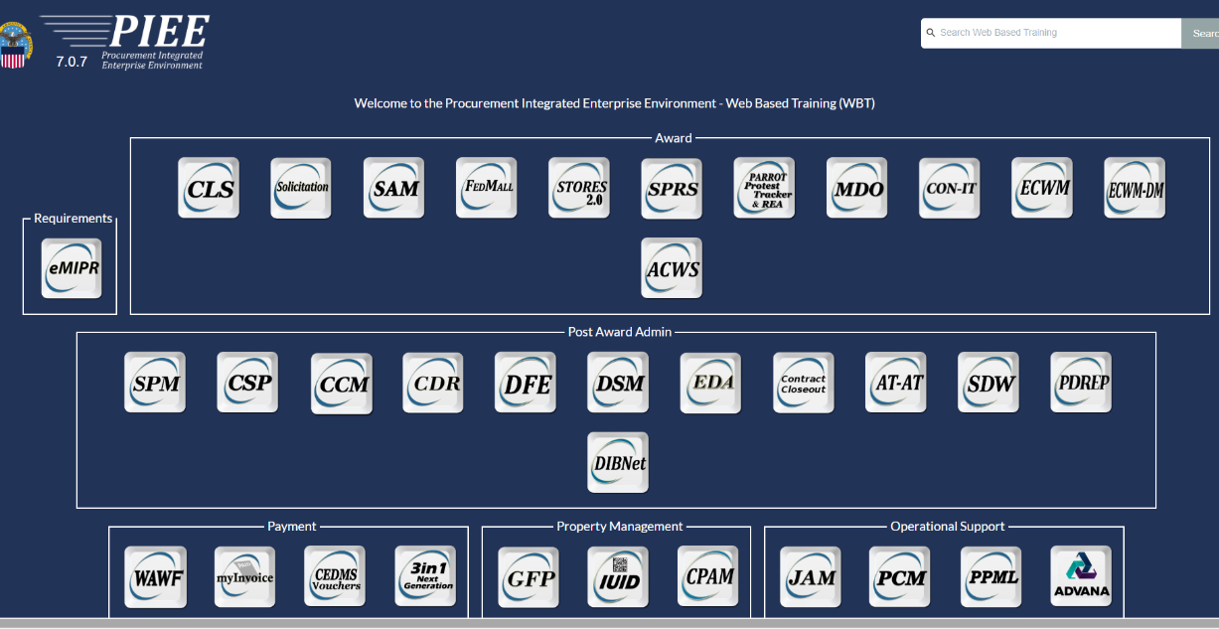
Procurement Integrated Enterprise Environment (PIEE)
What is PIEE?
The Procurement Integrated Enterprise Environment (PIEE) is the DoD and federal one-stop-shop for procurement capabilities.
The PIEE is home to many modules, among them:
  Wide Area Workflow (WAWF)
  MyInvoice
  Solicitation
  SPRS
https://piee.eb.mil/

Slide 25
Procurement Integrated Enterprise Environment (PIEE)
What can you do in is PIEE?
  Bid on solicitations - Solicitation Module
  Up-load cybersecurity score (NIST 800-171) - SPRS Module
  Submit the Invoices and Get Paid - Wide Area Workflow (WAWF) Module
  View the status of the invoices – My Invoice Module
https://piee.eb.mil/

Slide 26
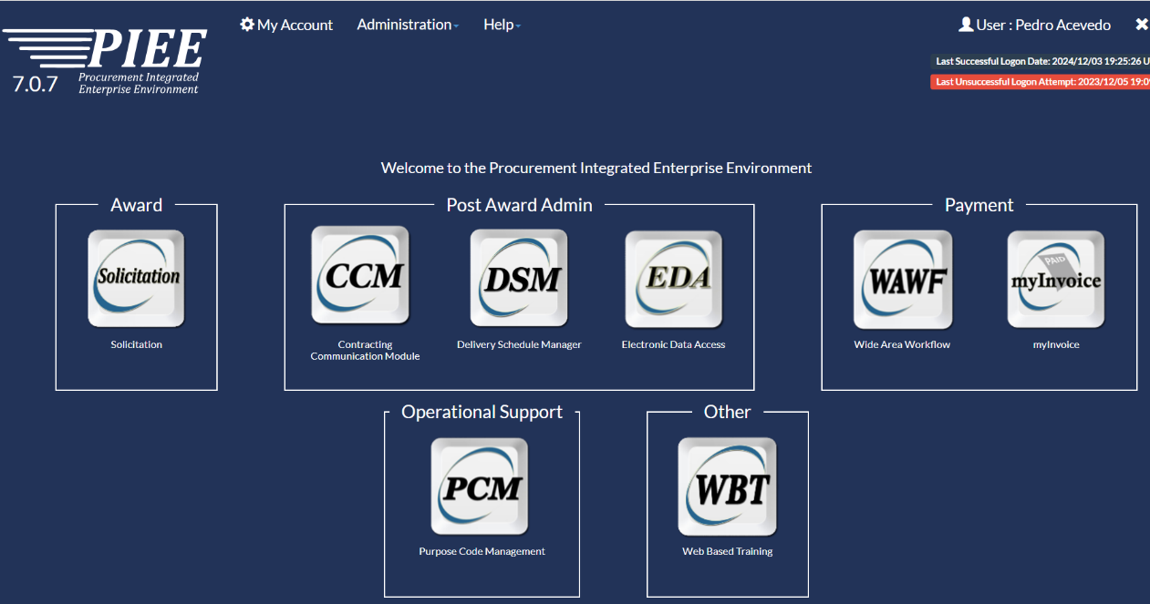
Procurement Integrated Enterprise Environment (PIEE)
What can you do in PIEE?
Solicitation Portal
  The Solicitation Portal is currently in a pilot phase and allows the government to post solicitations, including restricted attachments, and receive proposals, in a secure environment. It will eventually allow contract writing systems to post solicitations as data which can be converted into a contract and will interface with government point of entry to post synopses.
https://piee.eb.mil/

Slide 27
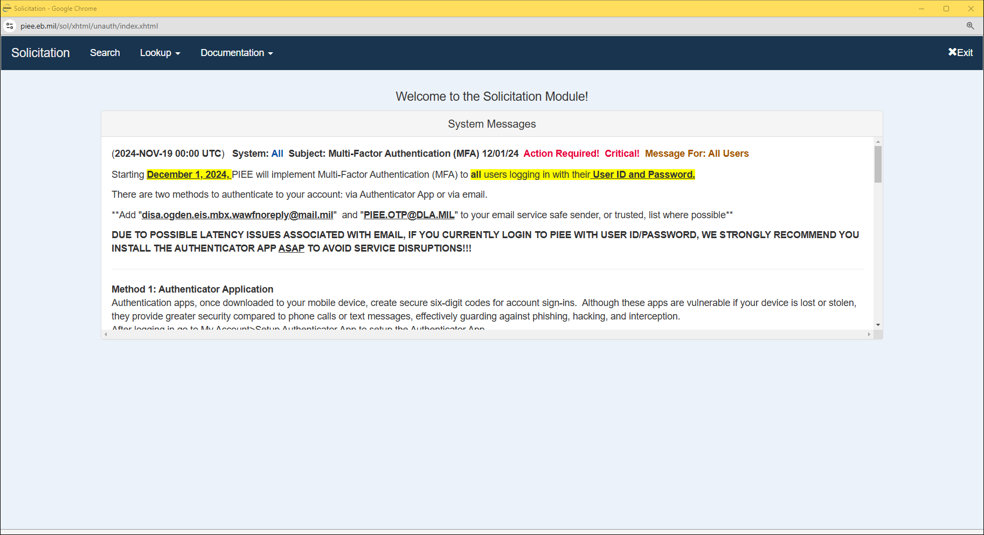
Procurement Integrated Enterprise Environment (PIEE)
https://piee.eb.mil/

Slide 28
solicitation structure: what you should know
VOLUME 1
Standard Form 1442 – Offer/Award
Section 00 10 00 - Bid Schedule
Section 00 21 00 – Instructions to Offerors
  Best Value Acquisitions – 00 21 16 Proposal Instructions/Evaluation Factors
Section 00 070 00 – Contract Clauses
  By Reference or By Full Text – Have the same effect on the contract.
  Federal Acquisition Regulations & Defense Federal Acquisition Regulations
Section 00 80 00 – Special Requirements
  USACE Acquisition Instruction (UAI)
  Other Clauses
  Local Requirements (i.e. Taxes)

Slide 29
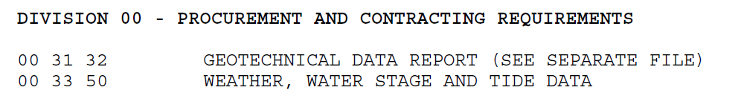
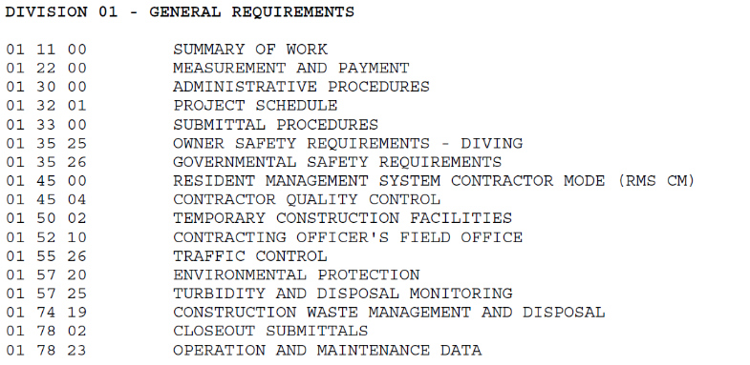
solicitation structure: what you should know
VOLUME 2
Division 00 - Procurement and Contracting Requirements
Division 01 – General Requirements
  How the contract will be administered?
Technical Requirements/Specifications
  Division 02 & Up
VOLUME 3
Plans (D-B-B only)
Attachments

Slide 30
Partner with us!
ONE TEAM, ONE MISSION
Caño Martin Peña CNT-2
Rio Puerto Nuevo CNT-2
Roosevelt Bridge Replacement
Army Family Housing
    Website: https://www.saa.usace.army.mil
    LinkedIn: https://www.linkedin.com/company/u-s-army-corps-of-engineers-caribbean-district
    Facebook: https://www.facebook.com/CaribbeanDistrictUSACE
    SAA Office Small Business Programs Email: saa-sb@usace.army.mil

