Slide 1

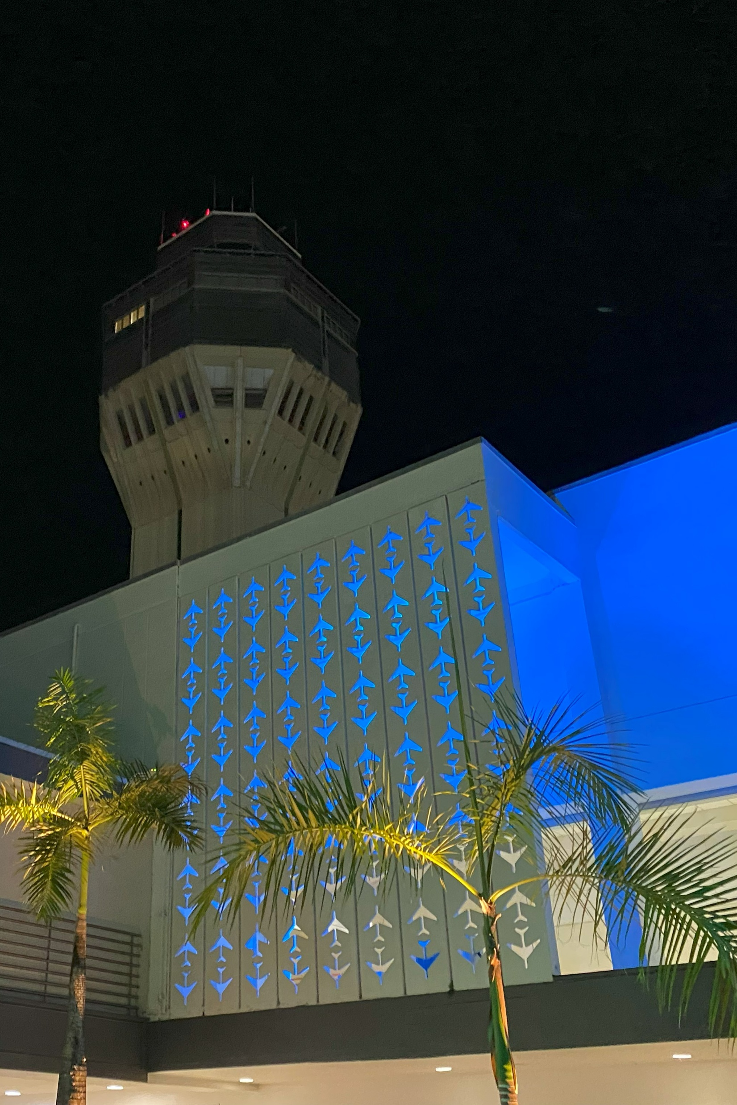


Luis Muñoz Marín International Airport
AGC Transportation Conference
May 28, 2026

Slide 2
SJU Airport
1,438 Acres
Critical Infrastructure
Runway 8-26
10,400 x 193
Terminal D
3 Contact Gates
Terminal C
9 Contact Gates
Terminal A
8 Contact Gates
Terminal B
10 Contact Gates
Runway 10-28
8,016 x 150
2

Slide 3

SJU Historical Passenger Movement

Slide 4
SJU Passenger Movement
13.6M
2025 Annual Passengers
23-YEAR offset

Slide 5
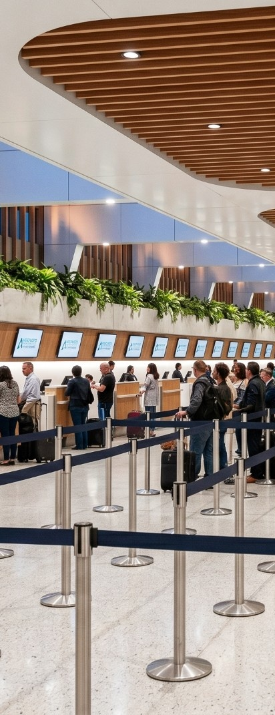

Terminal Rehabilitation & Improvement Program (TRIP)
c
2025
2030
2035
2040
2045
2050
Development Timeframe
Baseline
Phase 1
Phase 2
Phase 3 Alternate
Phase 4
Combined All-
Terminal Peak Hour
4,485
+15%
5,152
+6%
5,479
+6%
5,790
Components
+2
+308k
+4
Total
Gates
Total SF*
TSA Lanes
USDA Lanes
+2
+203k
+4
+3
+187k
+1
+7
+698k
+4
+5
5

Slide 6
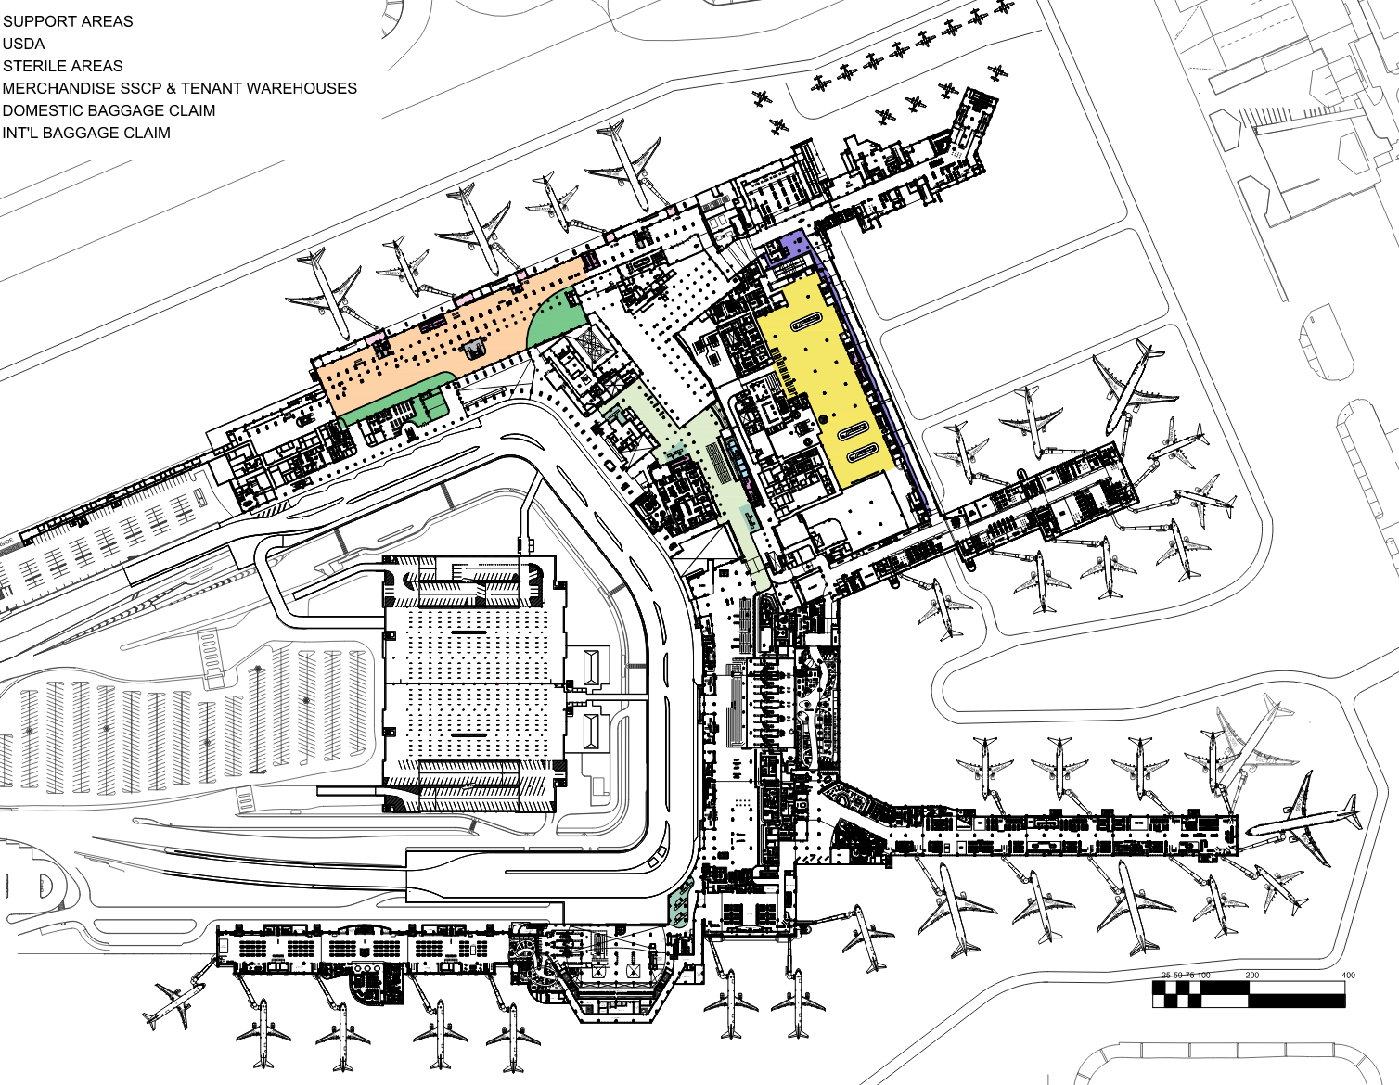
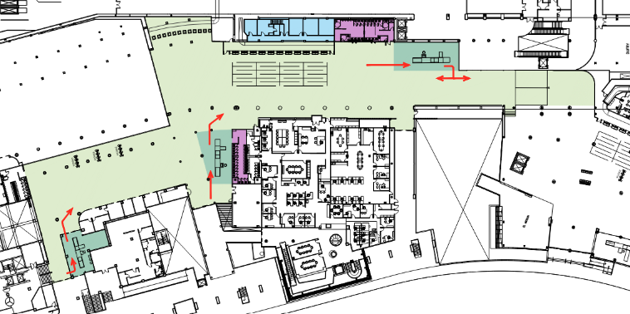
Terminal Rehabilitation & Improvement Program (TRIP)
t
Phase 1
2025-2029
Gates
Total SF*
TSA Lanes
USDA Lanes
+2
+308k
+4
Passenger Capacity Improvements:
4 New additional USDA positions
Relocation of Check-In Positions to Terminal D
2 New contact gates
Expansion of International Baggage Claim in Terminal D FIS
5 new additional restrooms
Additional 19,000 SF of post-security concessions
Infrastructure Improvements:
Interconnection Terminal A and Terminal B/C Baggage Handling Systems
Baggage Handling Expansion to Terminal D
Terminal D Chiller Plant, including replacement of chilled water mains and branch piping.
Second Level
6

Slide 7
PBB’s
32 New Boarding Bridges
+2 Additional Gates by 2031
Total Project Cost
$67.4M
Terminal D
3 Contact Gates
Terminal C
9 Contact Gates
Terminal A
8 Contact Gates
Terminal B
10 Contact Gates
7

Slide 8
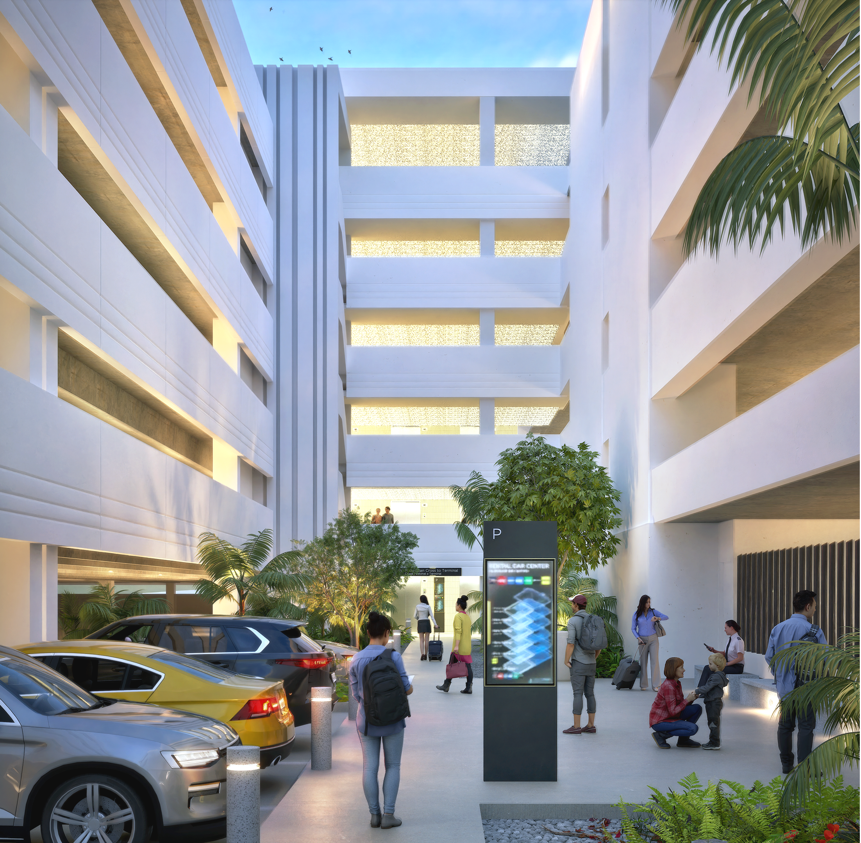
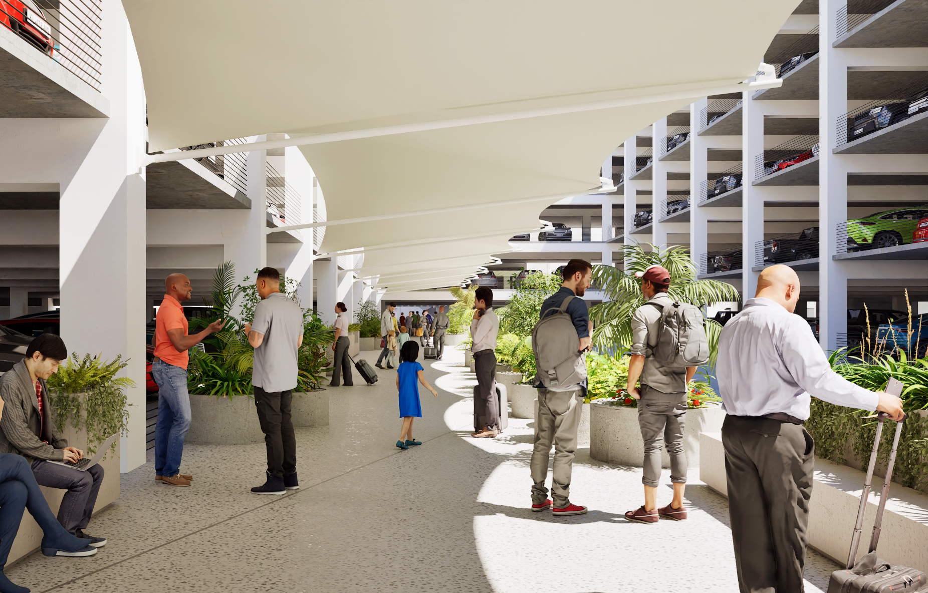
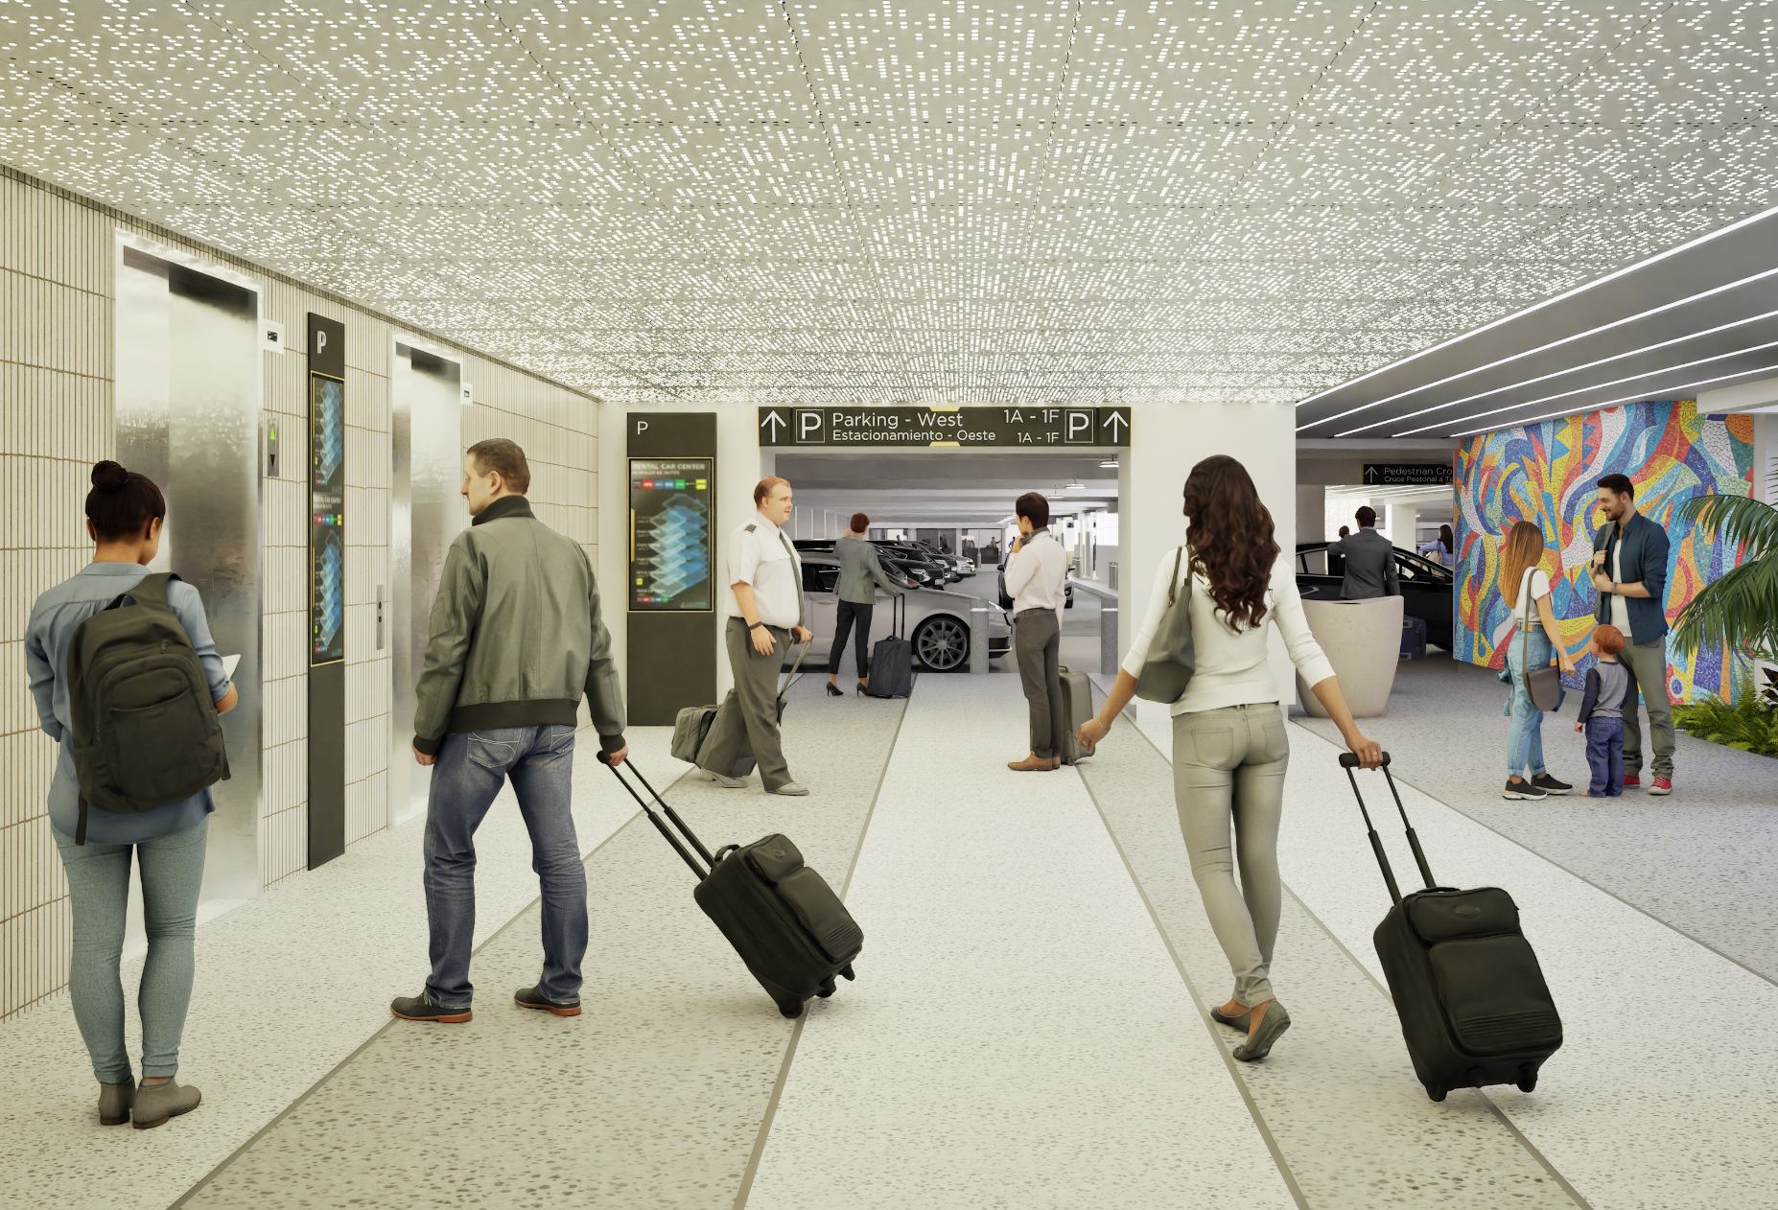
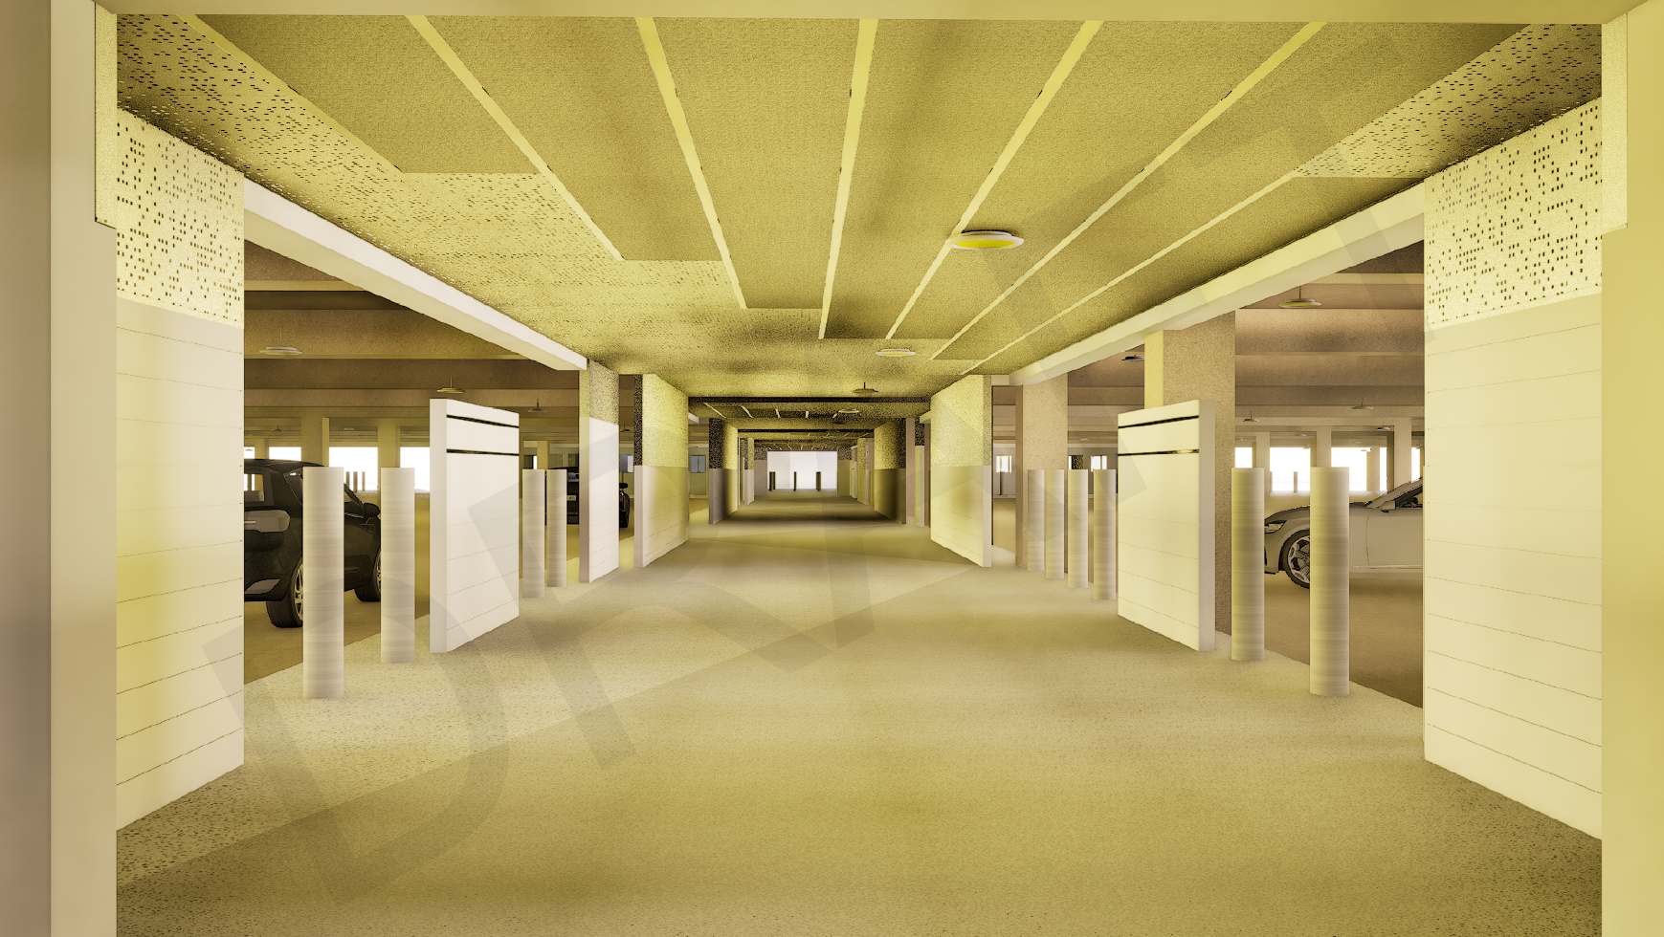
Multilevel Parking Expansion

Slide 9
Multilevel Parking Expansion
Project Timeline
APRIL
JUNE
90% CD’s Issuance
Infrastructure Government Agencies Endorsement Submitted
100% CDs Issuance
Construction Permit Submission
OCTOBER
DECEMBER
Schematic Design Submittal
Design Workshops
70% CDs Issuance
2025
2026
2026
2030
NOVEMBER
JANUARY
MARCH
JUNE
JULY
RFP Stage 1
(Statement of Qualifications sent)
RFP Stage 2 (Additional Information sent to Qualified GC)
Pre-Bid Meeting
GMP Cost Proposal Delivery
Contractor Selection
Award Date
OCTOBER
JAN
Notice to Proceed 1
Project Completion
Design
Procurement
Construction

Slide 10
SJU APMS
Airport Pavement Managment System
16.2 million
sqft of airfield pavement
Every 5 years
10
Notes:
Aerostar manages approximately 16.2 million square feet of airfield pavement at Luis Muñoz Marín International Airport (SJU) and maintains an Airport Pavement Management System (APMS) in accordance with FAA requirements.
This system supports federal funding eligibility and serves as a key tool for planning and prioritizing pavement-related investments within Aerostar’s Capital Improvement Program (CIP).
Since the last APMS update in 2020, several major rehabilitation projects have been completed or are ongoing, and pavement conditions have evolved. This project focuses on updating the APMS with current data and analysis to ensure it remains an effective, reliable decision-making tool.
The effort includes comprehensive data collection, pavement condition assessments (PCI surveys), supplemental testing, traffic and fleet mix evaluation, and updated remaining life and Pavement Classification Rating (PCR) analyses. The project will ultimately deliver a prioritized Maintenance and Rehabilitation Plan with 5-, 10-, and 20-year projections, supported by updated mapping and reporting to guide future planning and investment decisions.-

Slide 11
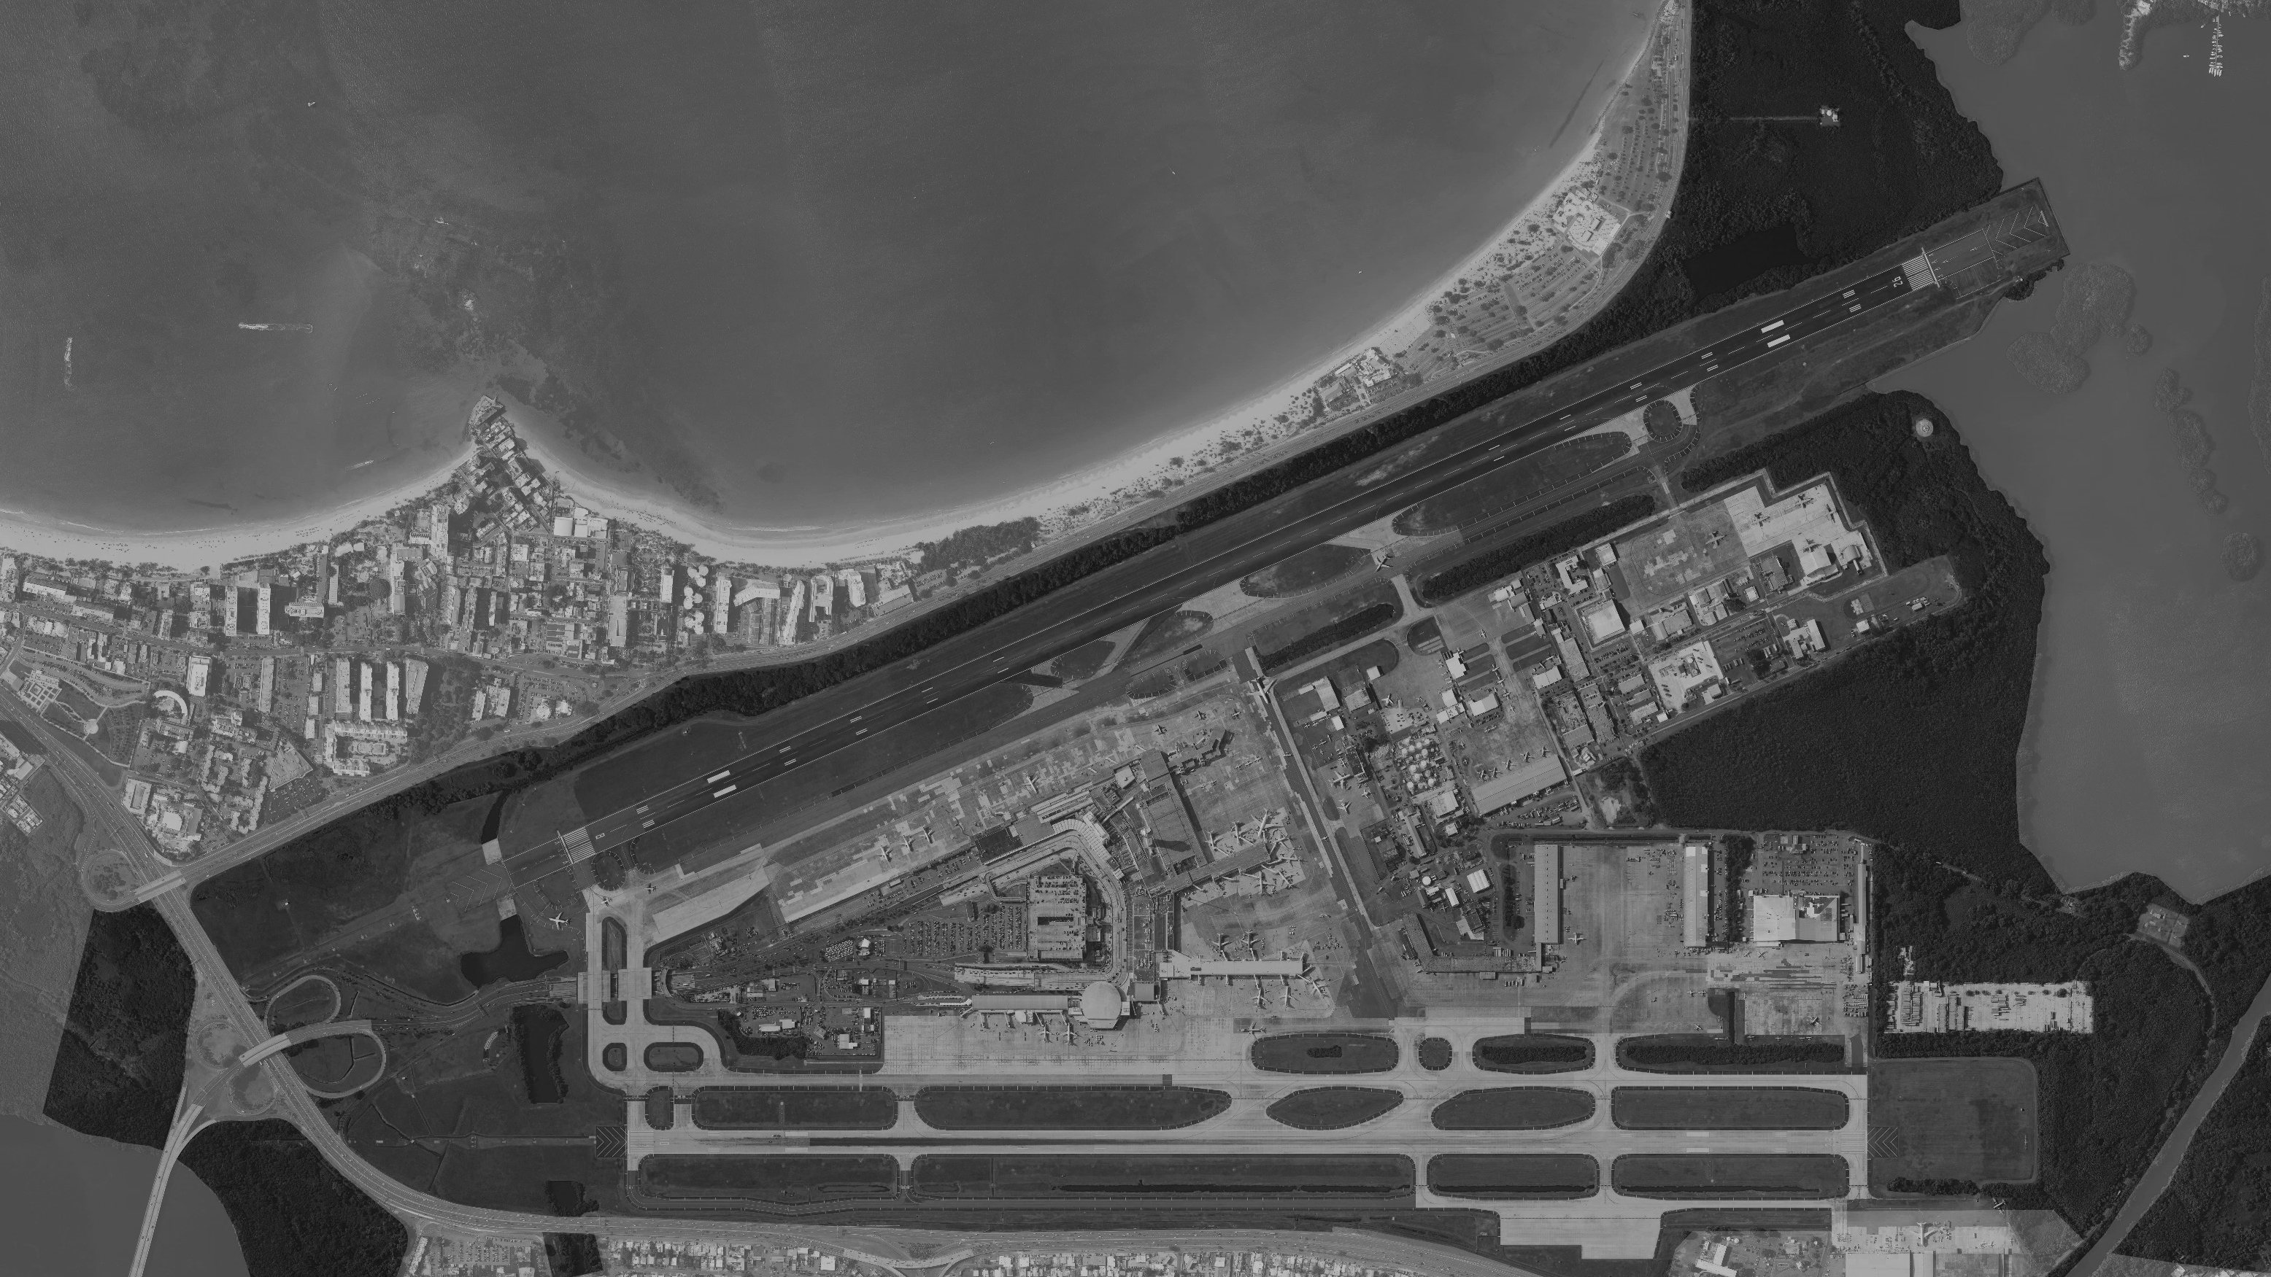
FAA Airport Capital Improvement Program FY 27-31
FY 28
(Ph1 Design)
8
15
FY 30
(Ph2 Construction)
FY2027
FY2028
FY2029
FY2030
FY2031
$65.96M
$12.56M
$15.93M
$22.68M
$15.18M
8
1
2
3
4
5
6
7
8
9
10
11
12
13
14
15
16
Airport Pavement Management System (2026)
Airport Electrical Infrastructure Master Plan (2026)
Runway 8-26 Object Free Area ROFA Clearing Ph3 Construction (2026)
Taxiway Sierra WEST Improvements Construction (2027)
Taxiway Sierra EAST Improvements Construction (2027)
Runway Safety Area Improvements Runway 10-28 Design (2028)
Taxiway H3-H4 Pavement Reconstruction Ph2 Construction (2028)
Airport Sustainability Project Design (2028)
Taxiway N2 Pavement Reconstruction (2028 & 2032)
Apron 3 Pavement Reconstruction (2029 & 2031)
Runway Safety Area Improvements Runway 10-28 Construction (2029)
Apron 6 Pavement Reconstruction Ph 1 Design (2029)
Taxiway J7 Geometrical Improvements Design (2029)
Taxiway J7 Geometrical Improvements Construction (2030)
Airport Sustainability Project Ph2 Construction (2030)
Apron 2 Pavement Reconstruction Ph 1 Design (2031)
FY 27-28
(Design/Construction)
8
3
5
FY 26
(Ph3 Construction)
FY 29
(Design)
9
4
FY 27-28
(Design/Construction)
16
FY 31
(Design)
FY 26
(APMS)
(AEIMP)
1
12
FY 29
(Design)
2
10
FY 29-32
(Construction)
8
7
FY 28
(Construction)
6
11
FY 28
(Ph1 Design)
FY 29
(Ph2 Construction)
FY 29
(Design)
13
14
8
11
FY 30
(Construction)

Slide 12
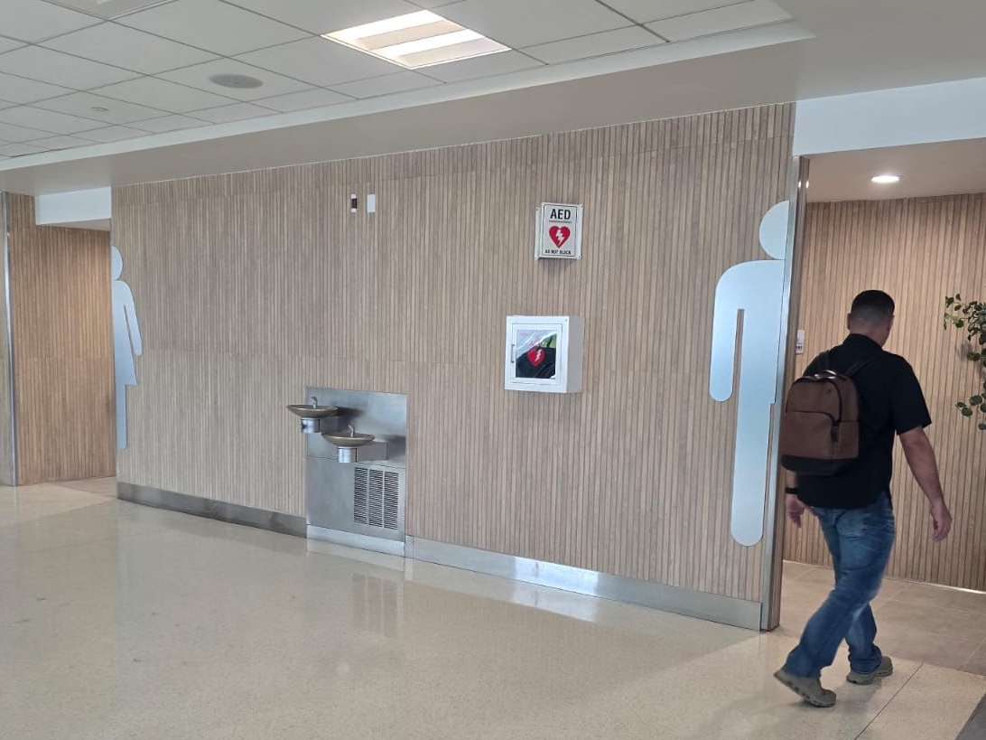
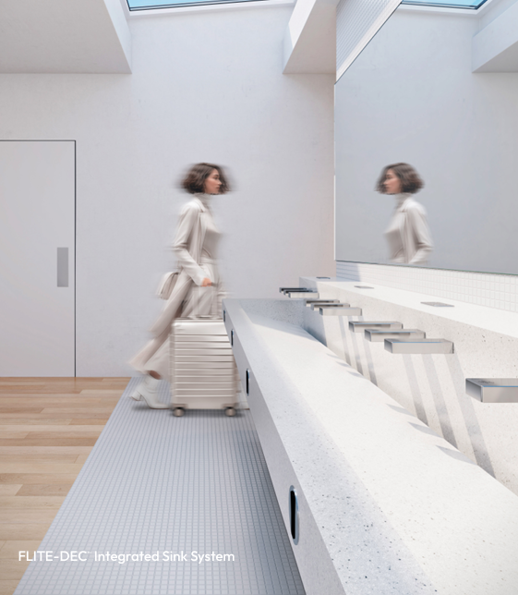
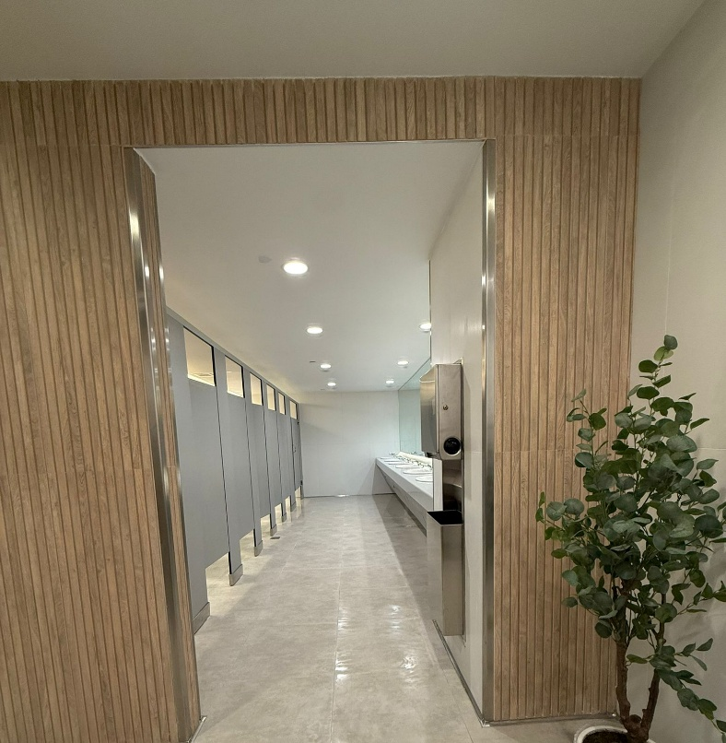
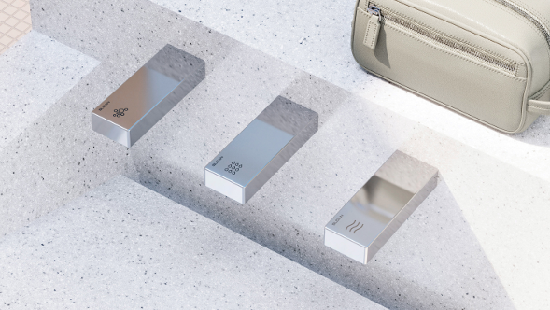
3
Impacted Cluster Restrooms
11
Upcoming Cluster Restrooms
Restrooms Rehabilitation Program
Expected Total Investment
$7.7M

Slide 13
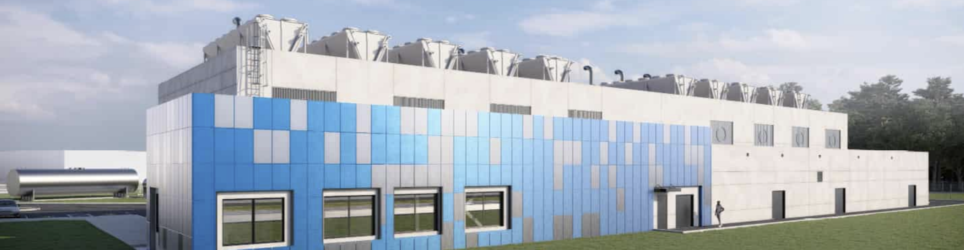
Energy & Resiliency Projects
Power Generation Plant
Project Overview
$132M
Purpose: Ensures airport operational continuity during grid disruptions and catastrophic events
Oversight: Shared among FEMA, COR3, PRPA, and Aerostar
Based on 60% design
Project Timing: 2021-2030
Funding Program: 100% FEMA Funded
Confirmed Items
Pending Authorization
Project eligibility validated within FEMA/COR3/PRPA pathways
Phase 1A completed; Phase 1B design deliverables advanced to 60%
Design deliverables support scope definition and baseline planning
Aligned with FEMA resiliency objectives and mitigation strategy
Power generator equipment purchase was approved by FEMA on April 27, 2026
Amendment to complete the construction drawings up to a 90%
FEMA and COR3 authorization for Phase 2 construction
Confirmation of construction sequencing and funding release timing
13

Slide 14
Capital Projects Expenditure Milestones
2026
Main Drivers
Parking Design and Construction
Roof Upgrade Plan
FIS Hallway Reconstruction
Commercial (Stores and Parking System Improvements)
Terminal D Rehab Ph2
Multilevel Parking Lobbies
Baggage Claim B/C Rehab
PBB’s Replacement
TWY N1 Const
$57M
Restroom Rehab Prog
ROFA
Inner Traffic Lane Phase 2
Taxiway S - Design
Security Infrastructure
Real Estate
IT (Equipment Purchasing)
$48.9M

Slide 15
Luis Faure Bosch, MEM, PE, CM
Chief Infrastructure Officer
Luis Muñoz Marín International Airport
Thank you
AGC Transportation Conference

