Slide 1
AGC-PR
Transportation Forum
28 de mayo de 2026

Slide 2
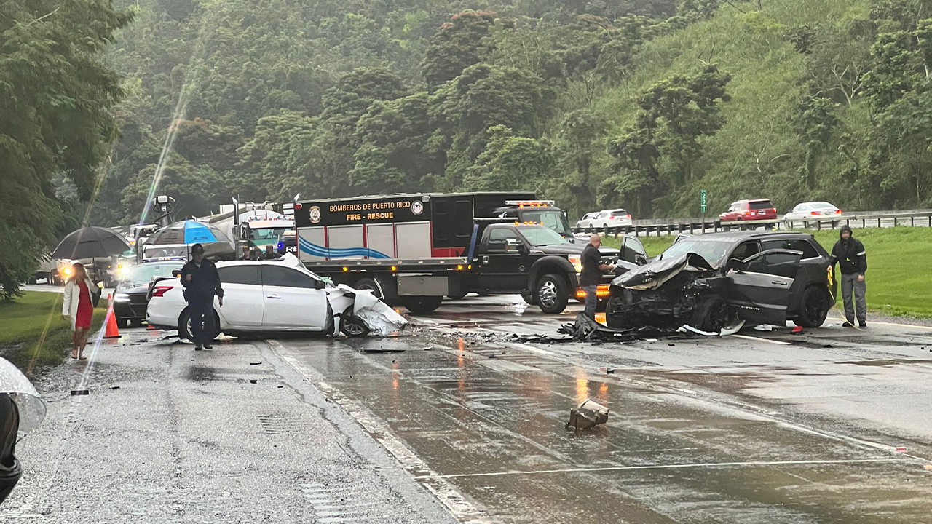
19 People Died This Month

Slide 3
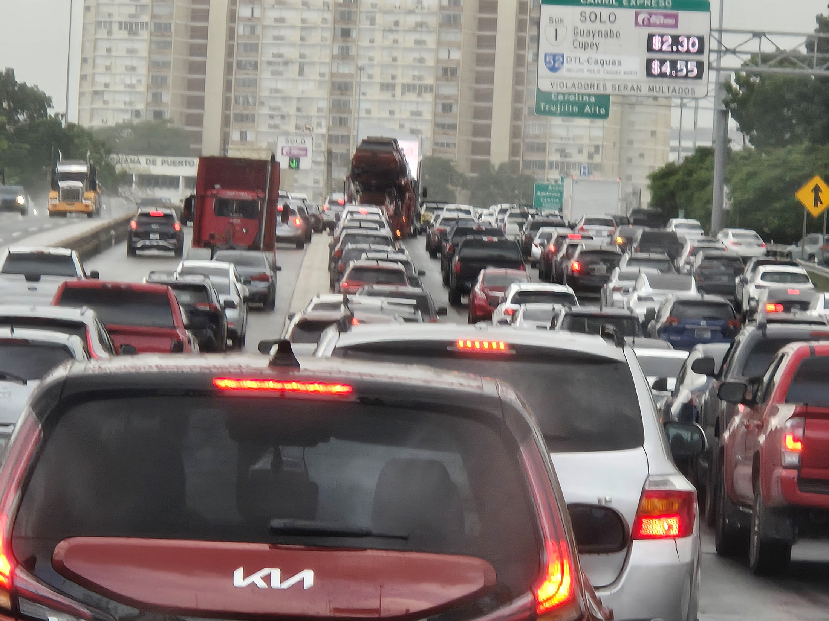

Slide 4
Road Conditions
It is important to measure road conditions.
Federal Requirements are to set Pavement Condition targets (23 CFR 490.319)
National Performance Management Measures for the Assessing Pavement Condition (PM2)

Slide 5
Road conditions continued…
  Puerto Rican roads are not meeting
  the condition targets

Slide 6
Bridge Conditions
It is important to measure bridge conditions
Federal Requirements are to set Bridge Condition targets

Slide 7
Bridge Conditions continued…
  The number of “Critical Findings” Bridges is increasing, not decreasing

Slide 8


Slide 9
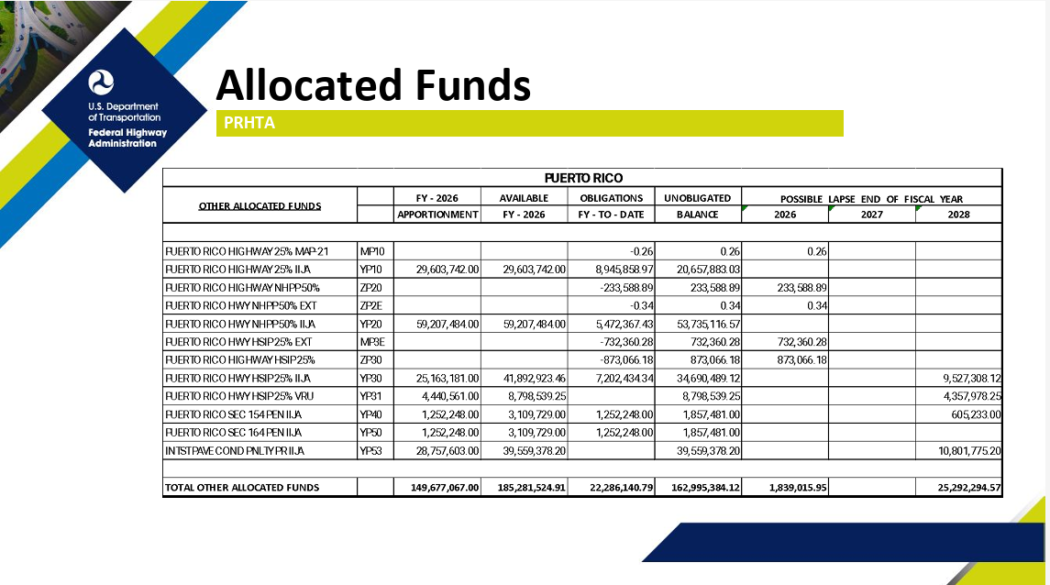
Funding Available

Slide 10
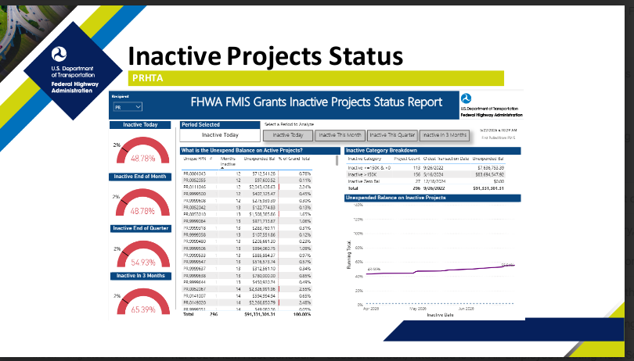

Slide 11
What do ?
We all have a role
USDOT/Federal Highway Administration is:
Providing a record level of $, highest in history
New Funding Programs (Competitive Grants). Puerto Rico is successful in some proposals. Example: PR 2 La Vita is largest Grant in history
Help move projects forward, not be a hurdle, be a facilitator. “Your success is my success”. Align goals
Memorandum of Understanding/Agreement (MOU) with Carreteras
Provide Technical Assistance/Training
Promote Innovation (Every Day Counts EDC)
Established Artificial Intelligence (IA) “Center of Excellence”

Slide 12
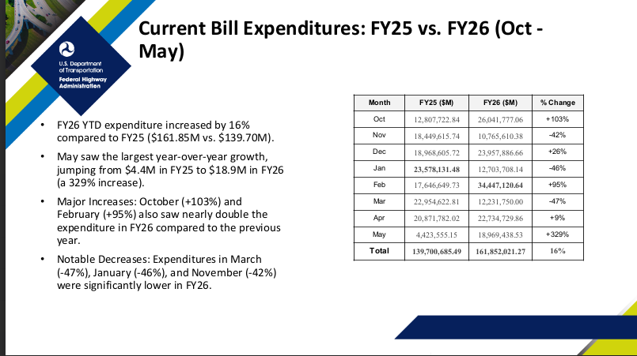

Slide 13
USDOT Strategic Plan
Mission: Advance safety. Move people and goods. Build big and beautiful infrastructure.
Vision: Usher in a Golden Age of transportation for the United States.
Values:
Safety first
Back to basics
Affordability and efficiency
Slash red tape
Accelerate American innovation
Restore maritime dominance
Unleash American energy

Slide 14
US DOT Goals
SAFETY: Reaffirm that safety is the Department’s top priority
INFRASTRUCTURE: Invest in high-quality transportation infrastructure capacity to unlock American prosperity
INNOVATION: Lead the world by bringing the best of American ingenuity to transportation
EFFICIENCY: Improve efficiency and accountability across the Department

Slide 15
The Future – What is coming….
Approx 20 new Notice of Funding Opportunities (NOFO) before Sept 2026
IIJA/BIL is our current Federal Legislation. It expires 30 Sept
Current efforts for US Congress to pass new Legislation. Now time to influence the outcome
Every Day Counts (EDC 8) coming with new Innovations

Slide 16
Every Day Counts EDC 8
Advancing Nighttime Work Zone Safety
Beyond Bid-Build: Innovative Project Delivery Methods
Connected Corridors
Integrated Digital Project Delivery
Subsurface Utility Engineering (SUE)
UAS 2.0: Innovative Infrastructure Management

Slide 17
In Summary - We are Optimistic
We can be successful – We can all work together and save lives and improve people’s lives
Every Day Counts
US DOT and Federal Highways is 100 % committed to improve safety and transportaiton
Thank you for what you do everyday

