Slide 1
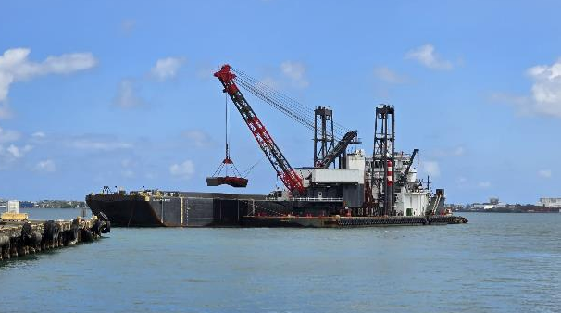
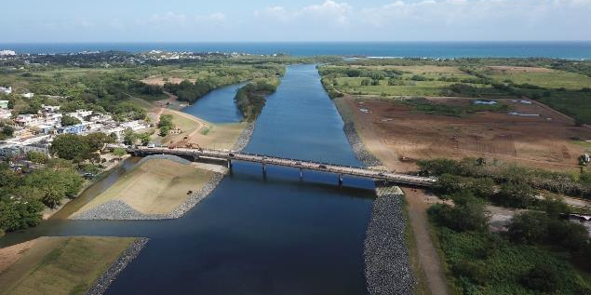

U.S. Army Corps of engineers
Caribbean District
USACE Caribbean District Business Opportunities for 2026-27
Date: 28 May 2026
Presented by:
Maricarmen Crespo, P.E.
Chief of Construction
San Juan Harbor Improvements
Rio de La Plata, Dorado Bridge and ACBM Toe Key Construction

Slide 2


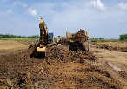
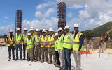
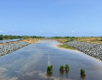
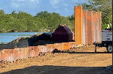
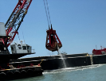
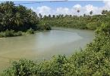
FY26-27 CONTRACT OPPORTUNITIES
Service Contracts & Civil Works
A&E / SERVICE / CMS CONTRACTS
PROGRAM | PROJECT NAME | SOLICITATION TYPE | STATUS
Civil Works MILCON | AE Design MATOC IDIQ | SB Set-Aside Pool, Unrestricted Pool | Advertised
All | QA Services SATOC IDIQ | SB Set-Aside | Advertise Q4 FY26
All | AE Survey MATOC IDIQ | SB Set-Aside | Advertise Q4 FY26
CONSTRUCTION CONTRACTS
PROGRAM | PROJECT NAME | MAGNITUDE OF CONSTRUCTION | ACQUISITION STRATEGY | SOLICITATION TYPE | STATUS
Civil Works | Rio de la Plata (Contract 1) | $300M-$400M | Unrestricted | BVTO | Advertised 20 May 2026
Civil Works | Rio Puerto Nuevo (Contract 1) | $100M - $250M | Unrestricted | BVTO | Advertise by Q4 FY27
Civil Works | Rio de la Plata Super-Aqueduct Relocation | $50M-$100M | TBD | BVTO | Advertise FY27

Slide 3
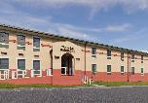
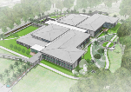
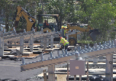
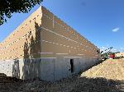
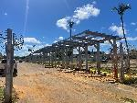
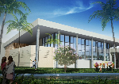
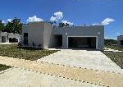
FY26-27 CONTRACT OPPORTUNITIES
MILCON & ERCIP
CONSTRUCTION CONTRACTS
PROJECT MISSION | PROJECT NAME | MAGNITUDE OF CONSTRUCTION | ACQUISITION STRATEGY | SOLICITATION TYPE | STATUS
All | DB-DBB Construction MATOC IDIQ | $100M-$250M | Unrestricted | - | Advertise Q4 FY26
ERCIP | Ft Buchanan Microgrid | $25M - $100M | SB Set-Aside | BVTO | Expected Award 23 JUL 26
ERCIP | Ft. Buchanan Potable Water Purification System | $20M+ | TBD | TBD | Design
MILCON | St. Croix Vehicle Maintenance Shop | $25M-$100M | TBD | TBD | Advertise Q3 FY27
MILCON | Ft Buchanan Antilles Middle-High School | $150M+ | TBD | TBD | Advertise Q3 FY28
MILCON | Ramey New School | $150M+ | TBD | TBD | Advertise Q2 FY27

Slide 4
FY26-27 CONTRACT OPPORTUNITIES
International & Interagency Services
CONSTRUCTION CONTRACTS
PROGRAM | PROJECT NAME | MAGNITUDE OF CONSTRUCTION | ACQUISITION STRATEGY | SOLICITATION TYPE | STATUS
IIS | *Patillas Dam Seismic Retrofit | TBD | TBD | TBD | Design
IIS | Guajataca Dam Early Actions to Prepare Reservoir for Permanent Dam Safety Improvements | TBD | TBD | TBD | RFP Development for D/B
*Patillas Dam Seismic Retrofit Design Update and Industry Outreach Event: 11-12 June 2026
SAM.gov link: https://sam.gov/workspace/contract/opp/cca0dfa115554347bab29d995539964d/view

Slide 5
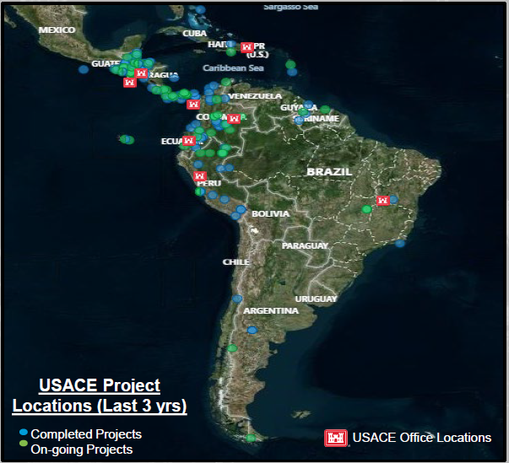
NEW MISSION – LATIN AMERICA
LATAM Mission Today:
100+ active efforts in 18 countries, $188M in ongoing Construction
$10M in ongoing Water Resources Technical Assistance
$7M in Real Estate Leases
$89M in FY26 Construction/Service Awards.

Slide 6
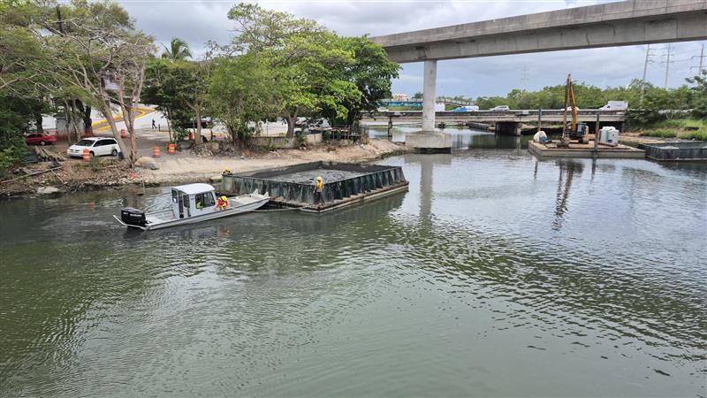
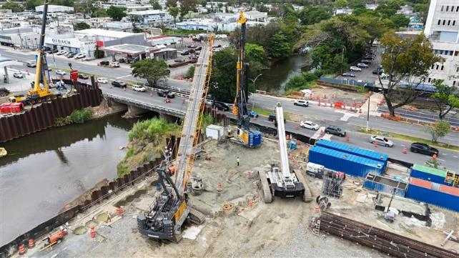
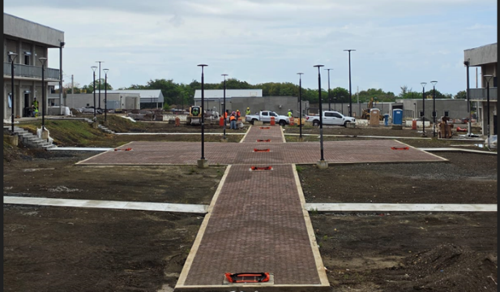
Partner with us!
ONE TEAM, ONE MISSION
Caño Martin Peña CNT-2
Rio Puerto Nuevo CNT-2
Roosevelt Bridge Replacement
Camp Santiago Joint Training Center
    Website: https://www.saa.usace.army.mil
    LinkedIn: https://www.linkedin.com/company/u-s-army-corps-of-engineers-caribbean-district
    Facebook: https://www.facebook.com/CaribbeanDistrictUSACE
    SAA Office Small Business Programs Email: saa-sb@usace.army.mil

